Slide 1
DESIGN OF STEEL STRUCTURE
BRANCH -CIVIL SEMESTER-6TH
DEPARTMENT OF CIVIL ENGINEERING
WRITTEN BY
ASST PROF. BARSHA BAISHALI JENA

Slide 2
UNIT-1
STEEL STRUCTURE

Slide 3
Table of content
Introduction
Structural steel
Advantages/disadvantages of steel as a structural material
Rolled steel section
Various types of load
Steel Properties
Design philosophy
Limit state design method
Riveted,bolted and pinned connection
Welded connection
Design of fillet welds

Slide 4
Introduction
Steel structure is a metal structure which is made of structural steel components connect with each other to carry loads and provide full rigidity.
A steel structure is composed of structural members that are made of steel having standard cross sectional profiles and standard chemical compositions and mechanical properties.
Steel is an alloy of primarily iron, carbon (1 to 2%) and small amount of other components (manganese, nickel, …)
• Carbon contributes to strength but reduces ductility.

Slide 5
Structural Design
Definition: Determination of overall proportions and dimensions of the supporting framework and the selection of individual members.
• Responsibility:The structural engineer, within the constraints imposed by the architect (number of stories, floor plan,..) is responsible for structural design
• Safety (the structure doesn’t fall down)
• Serviceability (how well the structure performs in term of appearance and deflection)
• Economy (an efficient use of materials and labor)

Slide 6
Advantages of steel as a structural material:
Elasticity: steel follows hooks law very accurately.
Ductility: A very desirable of property of steel, in which steel can withstand extensive deformation without failure under high tensile stresses, i:e., it gives warning before failure takes place.
Toughness: Steel has both strength and ductility. Additions to existing structures:

Slide 7
Disadvantages of steel as a structural material
Although steel has all this advantages as structural material, it also has many disadvantages.
Maintenance cost: Steel structures are susceptible to corrosion when exposed to air.
Fire proofing cost: steel is an incombustible material; however, its strength is reduced tremendously at high temperature due to common fires.
Fatigue: The strength of structural steel member can be reduced if this member is subjected to cyclic loading.
Brittle fracture: under certain conditions steel lose its ductility, and brittle fracture may occur at places of stress concentration. Fatigue type loadings and very low temperature trigger the situation.

Slide 8
Rolled steel section
The steel sections manufactured in rolling mills and used as structural members are known as rolled structural steel sections. The steel sections are named according to their cross sectional shapes.
TYPES OF ROLLED STRUCTURAL STEEL SECTIONS
Rolled Steel I-sections (Beam sections).
Rolled Steel Channel Sections.
Rolled Steel Tee Sections.
Rolled Steel Angles Sections.
Rolled Steel Bars.
Rolled Steel Tubes
Rolled Steel Flats.
Rolled Steel Sheets and Strips.
Rolled Steel Plates

Slide 9
Types of Load
• Dead Loads (permanent; including self-weight, floor covering, suspended ceiling, partitions,..)
• Live Loads (not permanent; the location is not fixed; including furniture, equipment, and occupants of buildings)
• Wind Load (exerts a pressure or suction on the exterior of a building)
Earthquake Loads (the effects of ground motion are simulated by a system of horizontal forces)
• Snow Load (varies with geographical location and drift)
• Other Loads (hydrostatic pressure, soil pressure)

Slide 10
Steel Properties
The important characteristics of steel for design purposes are:
yield stress (Fy )
ultimate stress (Fu )
modulus of elasticity (E)
percent elongation (ε)
coefficient of thermal expansion (α)

Slide 11
MECHANICAL PROPERTIES OF STEEL
1. Yield stress of steel (fy) = range from 220 to 540 Mpa
2. Ultimate tensile strength = 1.2 fy
3. Modulus of Elasticity (Es) = 2 x 105 N / mm2
4. Shear Modulus of steel = 0.4 E
5. Poissons Ratio (i) Elastic Range = 0.3 (ii) Plastic Range = 0.5

Slide 12
Design Philosophies
• Allowable Stress Design Method (ASD)
• Load and Resistance Factor Design (LRFD)

Slide 13
Allowable Stress Design Method (ASD)
A member is selected such that the max stress due to working loads does not exceed an allowable stress.
• It is also called elastic design or working stress design.
allowable stress=yield stress/factor of safety
actual stress ⊆ allowable stress

Slide 14
Load and Resistance Factor Design (LRFD)
A member is selected such that its factored strength is more than the factored loads.
Σ(loads x L factors) ⊆ resistance x R factor
• Each load effect (DL, LL, ..)has a different load factor which its value depends on the combination of loads under consideration

Slide 15
Load Factors
The values are based on extensive statistical studies
DL only 1.4D
DL+LL+SL (LL domin.) 1.2D+1.6L+0.5S
DL+LL+SL (SL domin.) 1.2D+0.5L+1.6S
In each combination, one of the effects is considered to be at its “lifetime” max value and the others at their “arbitrary point in time “ values.

Slide 16
Limit State Method

Slide 17
Limit State Method
The limit state method is a balanced combination of the working stress method and the ultimate load design method.
It is also known as load and resistance factor design in structural engineering.
The limit state method helps us to know the capacity load or working load of the structure.
The motive of using the limit state method is to construct a safe and comfortable structure.
This method gives an idea about the serviceability requirement of limiting deflection and cracking.
To make a safe structure limit state method obey two criteria, one is the ultimate limit state ana another one is the serviceability limit state.
A limit state design makes a structure more safe, durable, and fit for human uses.
It gives the idea that the structure ongoing to build can carry the acting loads like dead loads, live loads, wind loads, and earth quick loads are not.

Slide 18
Limit State Design
Limit state design is known as load and resistance factor design.
The ultimate limit state method is known as the calculation method of all load that’s acting on the structure.
In serviceability limit stage, we have to calculate that the building that we are going to build that’s are adequately safe, and comfortable for human uses.

Slide 19
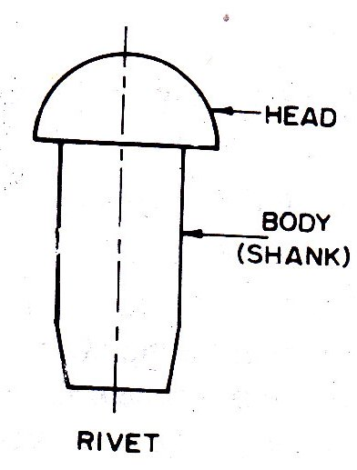
Riveted connections.
Rivet is a round rod which holds two metal pieces together permanently. Rivets are made from mild steel bars with yield strength ranges from 220 N/mm² to 250 N/mm².
A rivet consists of a head and a body as shown in Fig 5.1.
The body of rivet is termed as shank.
The head of rivet is formed by heating the rivet rod and upsetting one end of the rod by running it into the rivet machine.
The rivets are manufactured in different lengths to suit different purposes. The size of rivet is expressed by the diameter of the shank.
There are two types of riveted joints: lap joint and butt joint.
.

Slide 20
Riveted connections
LAP JOINT
BUTT JOINT
The two members to be connected are overlapped and connected together. Such a joint is called a lap joint.
The load in the lap joint has eccentricity, as the centre of gravity of load in one member and the centre of gravity of load in the second member are not in the same line.
To minimize the effect of bending in lap joints at least two rivets in a line should be provided.
Butt joint The two members to be connected are placed end to end. Additional plate/plates provided on either one or both sides, called cover plates and are connected to the main plates .
If the cover plate is provided on one side then it is called a single cover butt joint but if the cover plates are provided on both the sides of main plates it is called a double cover butt joint.

Slide 21
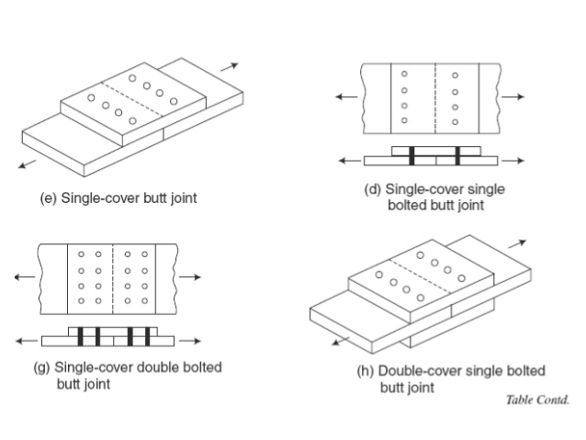

Slide 22
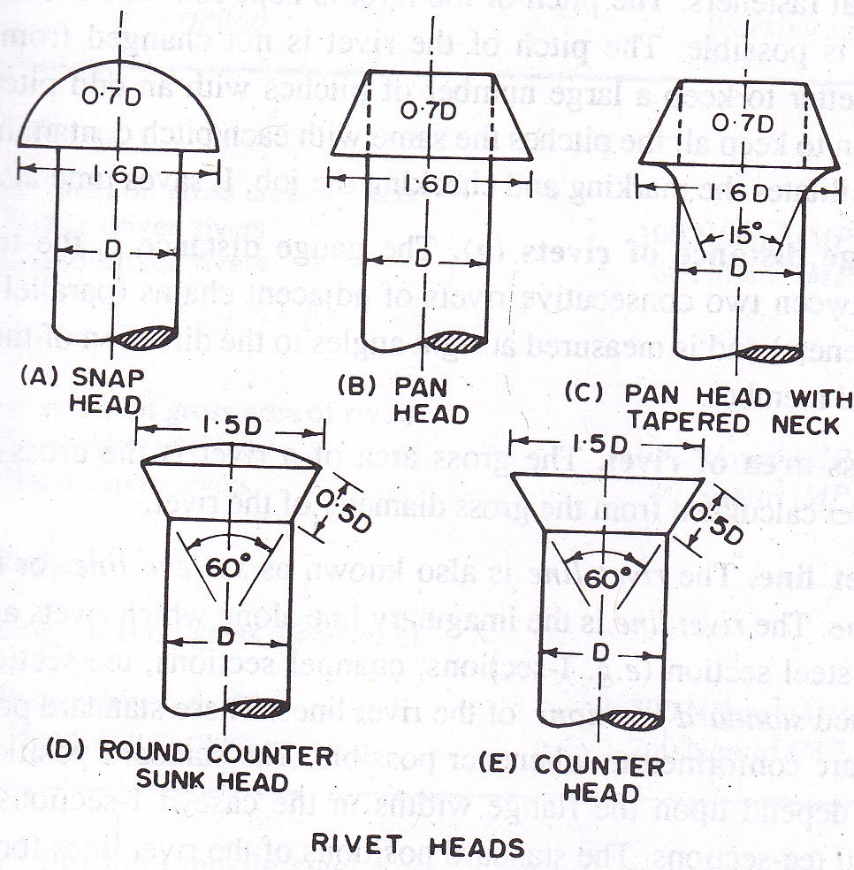
.
.

Slide 23
BOLTED CONNECTIONS
Bolted joints are one of the most common elements in construction and machine design.
They consist of fasteners that capture and join other parts, and are secured with the mating of screw threads.
There are two main types of bolted joint designs: tension joints and shear joints.

Slide 24
BOLTED CONNECTIONS
Steel washers are usually provided under the bolt as well as under the nut to serve two purposes:
To distribute the clamping pressure on the bolted member, and
To prevent the threaded portion of the bolt from bearing on the connecting pieces.
Bolts used in steel structures are of three types:
1) Black Bolts,
2) Turned and Fitted Bolts and
3) High Strength Friction Grip (HSFG) Bolts.
.

Slide 25
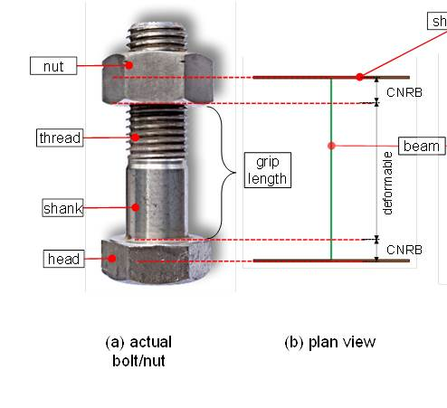
BOLTED CONNECTIONS
Uses
1. Bolts can be used for making end connections in tensions and compression member.
2. Bolts can also be used to hold down column bases in position.
3. They can be used as separators for purlins and beams in foundations
.

Slide 26
BOLTED SHEAR CONNECTIONS
We want to design the bolted shear connections so that the factored design strength (φ Rn) is greater than or equal to the factored load.
Shear failure of bolts
Average shearing stress in the bolt = fv = P/A = P/(π db 2 /4)
P is the load acting on an individual bolt
A is the area of the bolt and db is its diameter - Strength of the bolt = P = fv x (π db 2 /4) where fv = shear yield stress = 0.6Fy
Bolts can be in single shear or double shear as shown below.
When the bolt is in double shear, two cross-sections are effective in resisting the load. The bolt in double shear will have the twice the shear strength of a bolt in single shear

Slide 27
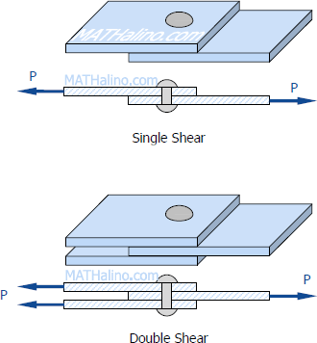
BOLTED CONNECTIONS
A lap riveted joint will be subjected to single shear, relatively it is a weak joint.
A butt riveted joint will be subjected to double shear, relatively it is a strong joint.
.

Slide 28
PIN CONNECTIONS
When two structural members are connected by means of a cylindrical shaped pin, the connection is called a pin connection.
Pins are manufactured from mild steel bars with diameters ranging from 9 to 330 mm. Pin connections are provided when hinged joints are required, i.e., for the connection where zero moment of free rotation is desired.
These also reduce the secondary stresses. These connections cannot resist longitudinal tension.

Slide 29
PIN CONNECTIONS
Various types of pins used for making the connections are forged steel pin, undrilled pin and dilled pin.
To make a pin connection, one end of the bar is forged like a fork and a hole is drilled in this portion.
The end of the other bar to be connected is also forged and an eye is made.
A hole is drilled into it in such a way that it matches with the hole on the fork end bar.
The eye bar is inserted in the jaws of the fork end and a pin is placed. Both the forged ends are made octagonal for a good grip.

Slide 30
PIN CONNECTION

Slide 31
Welded connection
Structural welding is a process by which the parts that are to be connected are heated and fused, with supplementary molten metal at the joint.
Welding is the method of locally melting the metals (sheets or plates – overlapping or butting) with intensive heating along with a filler metal or without it and allowing cooling them to form a coherent mass, thus creating a joint.
Welded structures are comparatively lighter than corresponding riveted structures.
Welded joints are economical to riveted joints due to low maintenance cost.
Welds may be classified into two main types namely butt-weld and fillet-weld.
1. Butt weld
This type of weld is used when the members are in same plane. Butt weld is also termed as groove weld. The butt weld is used to join structural members carrying direct compression or tension. It is used to make tee-joint and butt-joint. The following types of butt welds are in practice. These are named depending upon shape of the grove made for welding.

Slide 32
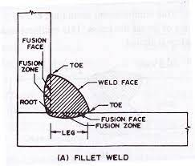
Welded connection
Fillet-weld:
This type of weld is used when the members to be connected overlap each other. A fillet weld is a weld of approximately triangular cross section joining two surfaces approximately as right angles to each other in lap joint or tee joint. When the cross section of fillet weld is 45˚, isosceles triangle . it is known as a standard fillet weld.
When the cross section of the fillet weld is 30˚ and 60˚ triangle . it is known as a special fillet weld.

Slide 35
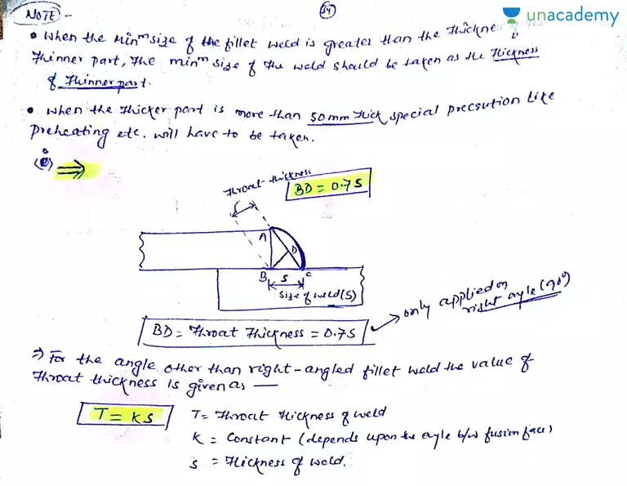

Slide 36
Q1-Two plates 16 mm thick are joined by i. a double U butt weld, ii. A single U butt weld. Determine the strength of the welded joint in tension in each case. Effective length of weld is 150 mm. Allowable stress in butt weld in tension is 142 N/mm².
.In case of double U but weld, complete penetration of weld takes place
Effective throat thickness of weld = 16 mm
Effective length of weld = 150 mm
Strength of single U butt weld = throat thickness x length of weld x permissible shear stress
= (16 x 150 x 142/1000) = 340.8 kN
ii.In case of single U butt weld, incomplete penetration of butt weld takes place
Effective throat thickness = 5/8 x 16 = 10 mm
Effective length of weld = 150 mm
Strength of single U butt weld = (10 x 150 x 142/1000) = 213.0 kN

Slide 37
Q2-In a truss girder of a bridge, a tie as shown in Fig. 7.18 is connected to the gusset plate by fillet weld. Determine the strength of the weld. The size of the weld in the fillet weld is 6 mm.
Size of weld = 6 mm
Effective throat thickness = 0.7 x 6 = 4.2 mm
Effective length of fillet weld = 200 + 200+ 200 = 600 mm
Strength of fillet weld= (4.2 x 600 x 110/1000 = 277.2 kN

Slide 38
Find out the answers.
What Is Structural Steel Design?
what Are The Mechanical Properties Of Structural Steel?
What Is The Minimum Size Of Bolt Used At Astm A32 N
How Many Bolts Minimum Required Per Connection.
What Is Minimum Thickness Of Any Part Of Structural Steel Shape?
What Are The Types Of Structural Steel?
What Are The Applications Of Steel Channels?

Slide 39
UNIT-2
TENSION MEMBERS

Slide 40
CONTENT
Tension members
Types
Behaviour of Tension Members
Net cross sectional area
Types of failure
Slenderness ratio
Design of tension member
Gusset plate

Slide 41
Tension members
Tension members are axially loaded members stressed in tension and are used in steel structures in various forms .They are used in trusses as web and chord members ,hanger and sag rods ,diagonal bracing for lateral stability and lap splices such as in a moment connection etc.
The strength of these members is influenced by several factors such as the length of connection, size and spacing of fasteners, net area of cross section, type of fabrication, connection eccentricity, and shear lag at the end connection connection.
The stress concentration near the holes leads to the yielding of the nearby fibres but the ductility of the steel permits redistribution of over stress in adjoining section till the fibres away from the holes progressively reach yield stress. Therefore at ultimate load it is reasonable to assume uniform stress distribution.

Slide 42
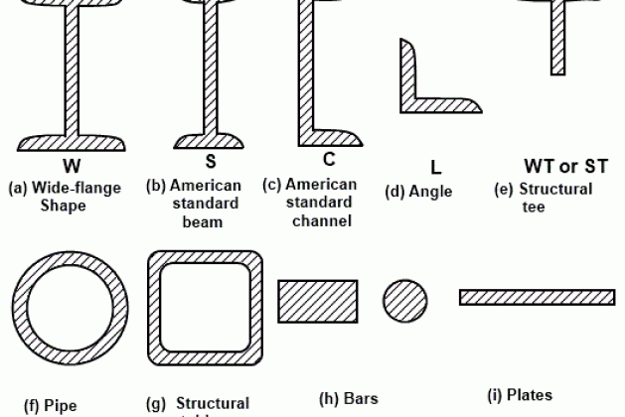
Types of tension members

Slide 43
Types of tension members
The types of structure and method of end connections determine the type of a tension member in structural steel construction. Tension members used may be broadly grouped into four groups.
Wires and cables,
Rods and bars
Single structural shapes and plates
Built-up members

Slide 44
(i) Wires and Cables
The wire types are used for hoists, derricks, rigging slings, guy wires and hangers for suspension bridges.
(ii) Rods and Bars
The square and round bars are shown in figures are quite often used for small tension members. The round bars with threaded ends are used with pin-connections at the ends instead of threads.
The ends of rectangular bars or plates are enlarged by forging and bored to form eye bars. The eye bars are used with pin connections. The rods and bars have the disadvantage of inadequate stiffness resulting in noticeable sag under the self weight.

Slide 45
.
(iii) Single Structural Shapes and Plates
The single structural shapes, i.e. angle sections and tee-sections as shown in figures are used as tension members. The angle sections are considerably more rigid than the wire ropes, rods and bars. When the length of tension member is too ling, then the single angle section also becomes flexible.
The single angle sections have the disadvantage of eccentricity in both planes in a riveted connection.
Single channel sections have high rigidity in the direction of web and low rigidity in the direction of flange

Slide 46
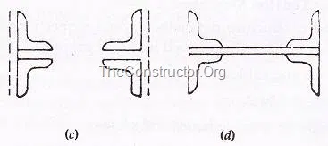
(iv)Built-up members
Two or more than two members are used to form built up members. When the single rolled steel section can not furnish the required area, then built-up sections are used.
The double angle sections of unequal legs shown in the figure are extensively used as tension members in the roof trusses.
The angle sections are placed back to back on two sides of a gusset plate, then built-up section has eccentricity in one plane and is subjected to tension and bending simultaneously.

Slide 47
Behaviour of Tension Members
If tensile force is applied to a steel bar, it will have some elongation.
If the force is small enough, the ratio of the stress and strain will remain proportional. This can be seen in the graph as a straight line between zero and point A – also called the limit of proportionality.
If the force is greater, the material will experience elastic deformation, but the ratio of stress and strain will not be proportional. This is between points A and B, known as the elastic limit.
Beyond the elastic limit, the mild steel will experience plastic deformation. This starts the yield point – or the rolling point – which is point B, or the upper yield point.
As seen in the graph, from this point on the correlation between the stress and strain is no longer on a straight trajectory. It curves from point C (lower yield point), to D (maximum ultimate stress), ending at E (fracture stress).

Slide 48
.

Slide 50
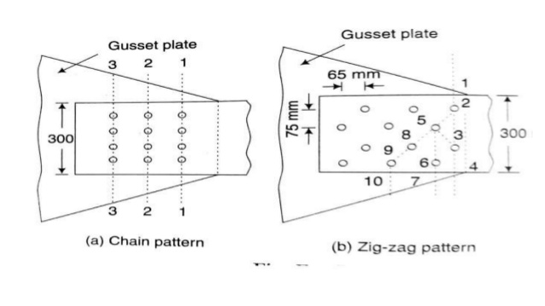

Slide 53
Types of failure
Failure due to Yielding of gross section
Failure due to Rupture of critical section
Failure due to block shear

Slide 62
Slenderness Ratio
The tension members have to be checked for minimum stiffness by stipulating the limiting maximum slenderness ratio of the member. This is required to prevent undesirable lateral movement or excessive vibration. The slenderness slenderness limits specified specified in IS: 800-2007 for tension tension members members are given in Table.

Slide 63
Q1-Determine the tensile strength of the 12 mm thick plate . Rivets used for the connection are 20 mm diameter. Allowable tensile stress is 150 N/mm².
Solution:
Diameter of the rivet hole = 20 + 1.5 = 21.5 mm
The critical section to be considered is a section like ABCDE.
Effective width at critical section = b – nd = 180 – (3 x 21.5) = 115.5 mm
Effective net area = 115.5 x 12 mm² = 1386 mm²
Strength of plate = 1386 x 150 = 207900 N = 207.9 kN.

Slide 64
Q2-Find the strength of the 12 mm thick plate shown in Fig. 9.2. All the holes are 21.5 mm as gross diameter. Take f_{t}=150 N/mm².

Slide 65
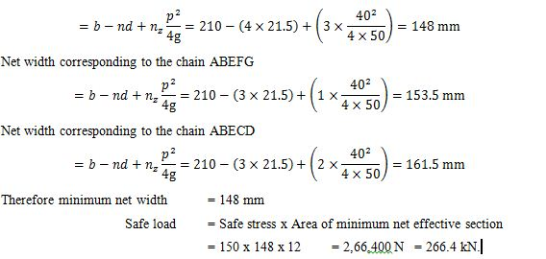
Solution:
Gross diameter of rivet hole = 21.5 mm
The effective net width will be computed along the various chain lines
Staggered pitch p = 40 mm
Gauge distance g = 50 mm
Net width corresponding to the chain ABCD = 210 – (2 x 21.5) = 167 mm
Net width corresponding to the chain ABECFG

Slide 66
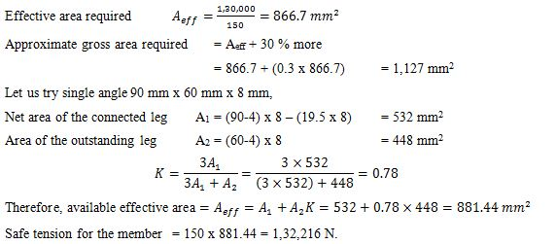
Q3-Design a single angle tension member to sustain a tension of 1,30,000 N. Use 18 mm diameter rivets.
But actual tension in the member is only 1,30,000 N. Hence the design is safe.

Slide 67
Q4-The tie in a bridge truss carries an axial tension of 350 kN. The member is to consist of two channels connected back to back on either side of a gusset plate. The diameter of rivets used for the connection is 16 mm. Two rivets are likely to appear in section. Design the member. Safe stress in tension is 150 N/mm².
Solution:
Dimensions of section = 125 mm x 65 mm
t_{f} = 6.6 mm
t_{w} = 4.4 mm
Gross area A_{g} = 1,367 mm² per channel
Diameter of rivet hole = 16 + 1.5 = 17.5 mm
Making allowance for four rive holes,
Net area provided = 2 x 1367 – (4 x 17.5 x 4.4) = 2,426 mm².
But the required area is only 2,333 mm². Therefore, the section selected is safe.

Slide 68
UNIT-3
COMPRESSION MEMBERS

Slide 69
CONTENT
Compression members
Effective length
Slenderness ratio
Types of cross section
Classification of cross section
Design of axially loaded compression members
Lacing
Battening
Design of column bases
Foundation bolts

Slide 70
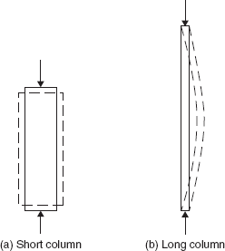
Compression members
Structural elements that are subjected to axial compressive forces only are called columns. Columns are subjected to axial loads thru the centroid.
Stress: The stress in the column cross-section can be calculated as f = P/A where, f is assumed to be uniform over the entire cross-section.
Accidental eccentricity and member out-of-straightness can cause bending moments in the member. However, these are secondary and are usually ignored.
Bending moments cannot be neglected if they are acting on the member. Members with axial compression and bending moment are called beam-columns.
.

Slide 71
Effective length
The vertical distance between the points of inflection of the column in the buckled configuration is termed as effective length 𝑙_{𝑒}.
The effective length is different from the unsupported
length 𝐿 of the member.
The relation between the effective and unsupported lengths of any compression member is 𝑙_{𝑒} = 𝑘𝐿
Where k=ratio of effective to the unsupported length.
Clause 25.2 of IS 456 stipulates the effective lengths of compression members (vide Annex E of IS 456). This parameter is needed in classifying and designing the compression members.

Slide 72
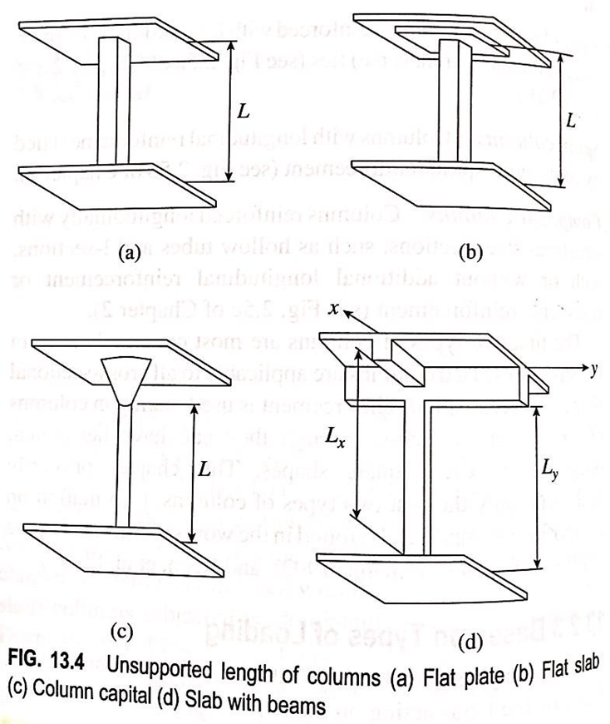

Slide 73
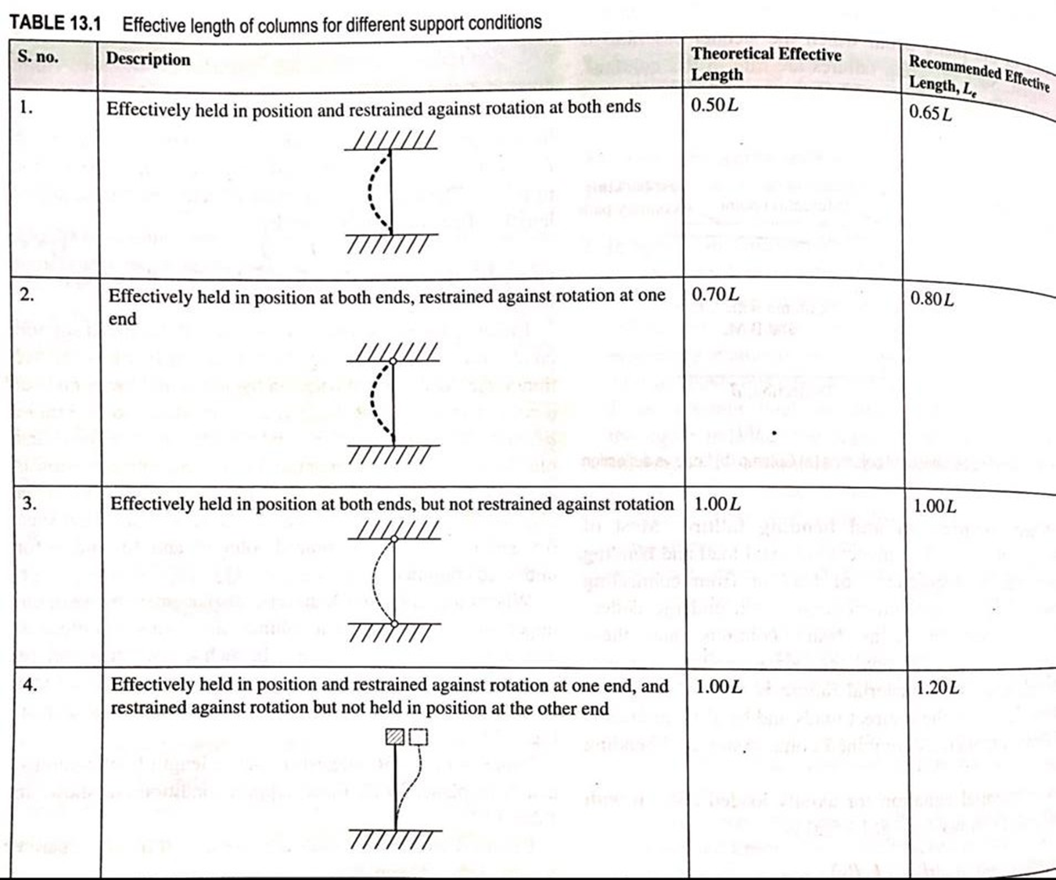

Slide 74
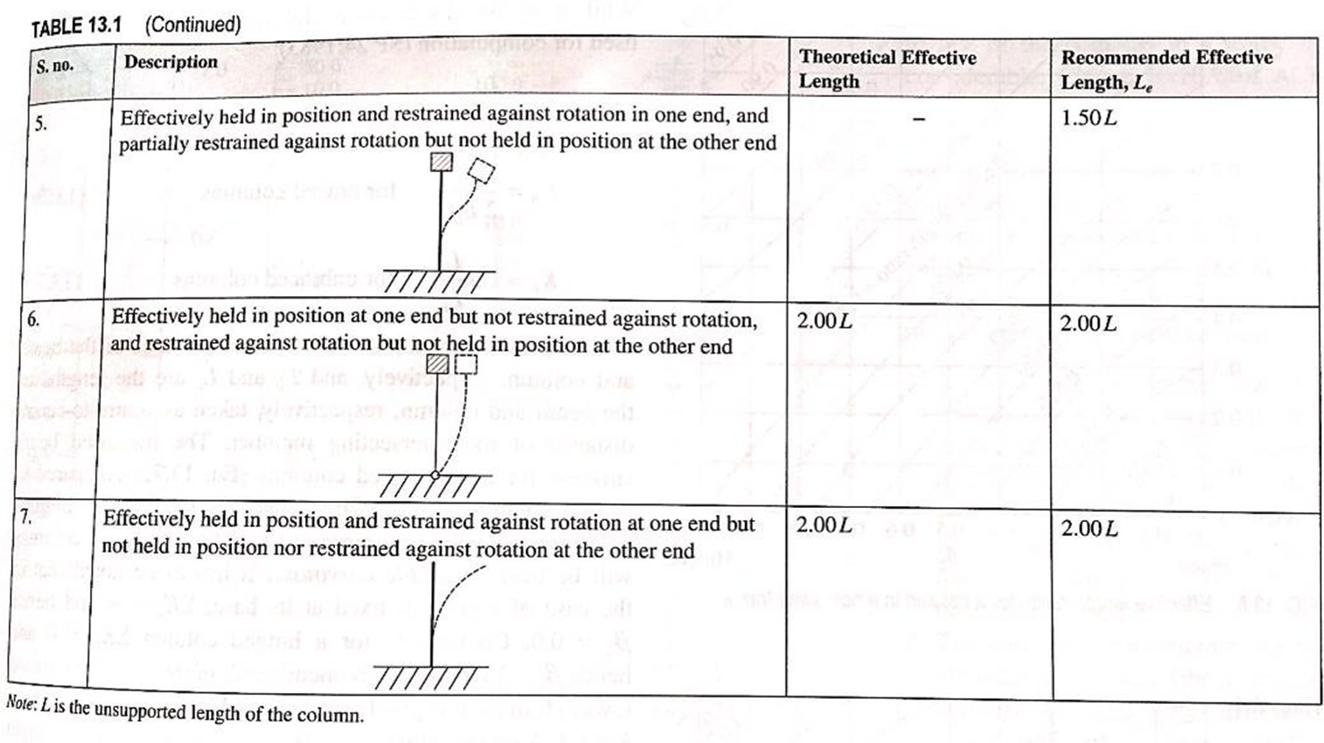

Slide 75
Slenderness ratio
The factor 𝑙_{𝑒} 𝑟 is called as the slenderness ratio.
It provides a measure of probability of column buckling.
short columns fail by crushing with the material reaching its ultimate strength.
Long columns fails in buckling

Slide 76
Based on slenderness ratio
Short column
Long or slender column
IS 456 stipulates the slenderness ratio as the ratio of its effective length 𝑙_{𝑒} to its least lateral dimension.
The effective length 𝑙_{𝑒} is different from the unsupported length.
The rectangular RC column of cross-sectional dimensions b and D shall have two effective lengths in the two directions of b and D.
Slenderness ratio about the major axis = 𝑙_{𝑒𝑥} 𝐷
Slenderness ratio about the minor axis = 𝑙_{𝑒𝑦} 𝑏

Slide 77
Design of axially loaded compression members
Columns subjected to loads acting along the longitudinal axis or centroid of column section.
ECCENTRICALLY LOADED COLUMN (uniaxial loading )
Loads which do not act on the longitudinal axis of the column section
ECCENTRICALLY LOADED COLUMNS (biaxial loading)
◆ If the eccentricity is with respect to both the axis (x and y axis) the column is said to be under biaxial loading.

Slide 78
ASSUMPTIONS IN DESIGN OF COMPRESSION MEMBER
Plane section normal to the axis remain plane after bending  Maximum strain in concrete at the outermost compression fibre is taken as 0.0035 in bending
The maximum compressive strain in concrete in axial is taken as 0.002 .
The tensile strength of concrete is ignored.

Slide 79
MINIMUM ECCENTRICITY IN COLUMNS
As per IS:456-2000,
All the column should be designed for minimum eccentricity
Minimum eccentricity(e)= unsupported length of column/500+Lateral dimension/30
emin= L/500+D/30 where L and D are in mm
emin≥20mm

Slide 80
SHORT AXIALLY LOADED COLUMNS
The figure shows rectangular column section subjected to axial load.
The column is subjected to uniform strain of 0.002 and uniform stress of 0.446fck.
Axial load where e=0
Pu=Puc+Pus
Pu=0.446fck*Ac+fs*Asc
Fy = stress in steel corresponding to a strain of 0.002.
=0.87fy for Fe 250
=0.79fy for Fe 415
=0.75fy for Fe 500

Slide 81
Cont….
I.S CODE adopts the critical value of 0.75fy for all grades of steel for finding out the pure axial load carrying capacity of columns.
Pu=0.446fck*Fck*Ac+0.75fy*Asc
Which is approximated as:
Pu=0.45fck*Ac+0.75Asc
Where Ac = area of concrete in column
Asc= area of steel in compression in column
If emin≤ 0.05D (IS:456-2000,CL.39.9)
Pu=0.4fck*Ac+0.67fy*Asc
It should be noted that equation above is the reduction in the capacity of the column by 10%

Slide 82
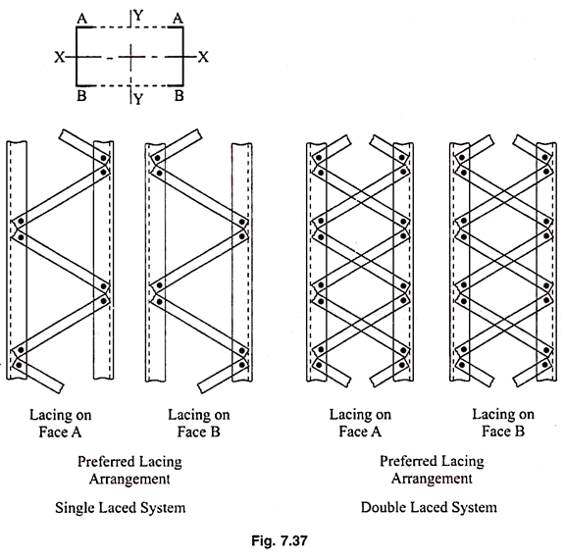
Lacing
There are two types of lacing system.
1. Single lacing system
2. Double lacing system

Slide 83
General Requirements for Lacing
(i) Compression members comprising two main components laced and tied, should where practicable have a radius of gyration about the axis perpendicular to the plane of lacing not less than the radius of gyration about the axis parallel to the plane of lacing.
(ii) As far as possible the lacing system shall be uniform throughout the length of the column.
(iii) Single laced systems on opposite faces of the components being laced together shall preferably be in the same direction so that one is the shadow of the other instead of being mutually opposed in direction.
(iv) The effective slenderness ratio (KL/r)_{e} of laced columns shall be taken as 1.05 times the (KL/r)_{o}, the actual maximum slenderness ratio, in order to account for shear deformation effects.
(v) Width of lacing bars – In bolted/riveted construction, the minimum width of lacing bars shall be three times the nominal diameter of the end bolt/rivet.

Slide 84
.
(vi) Thickness of lacing bars – The thickness of flat lacing bars shall not be less than one-fortieth of its effective length for single lacing and one-sixtieth of the effective length for double lacings.
(vii) Rolled sections or tubes of equivalent strength may be permitted instead of flats for lacings.
viii) Angles of inclination – Lacing bars, whether in double or single or double system shall be inclined at an angle not less than 40° nor more than 70° to the axis of the built-up member.
(ix) Spacing – The maximum spacing of lacing bars, whether connected by bolting, riveting or welding, shall also be such that the maximum slenderness ratio of the components of the main member (a₁/r₁) between consecutive lacing connections is not greater than 50 or 0.7 times the most unfavourable slenderness ratio of the member as a whole, whichever is less, where a₁ is the unsupported length of the individual member between lacing points, and r₁ is the minimum radius of gyration of the individual member being laced together.

Slide 85
Design of Lacings:
The lacing shall be proportioned to resist a total transverse shear V_{t}, at any point in the member, equal to at least 2.5 per cent of the axial force in the member and shall be divided equally among all transverse lacing systems in parallel planes.
For members carrying calculated bending stress due to eccentricity of loading, applied end moments and/or lateral loading, the lacing shall be proportioned to resist the actual shear due to bending in addition to that specified above.
The slenderness ratio KL/r, of the lacing bars shall not exceed 145. In bolted/riveted constructions, the effective length of lacing bars for the determination of the design strength shall be taken as the length between the inner end fastener of the bars for single lacing and as 0.7 of this length for double lacing effectively connected at inter sections.
In welded construction, the effective lengths shall be taken as 0.7 times the distance between the inner ends of welds connecting the single lacing bars to the members.

Slide 86
Cont….
The bolting riveting or welding of lacing bars to the main members shall be sufficient to transmit the force calculated in the bars.
Where welded lacing bars overlap the main members, the amount of lap measured along either edge of the lacing bar shall be not less than four times the thickness of the bar or the thickness of the element of the members to which it is connected, whichever is less. The welding should be sufficient to transmit the load in the bar and shall in any case, be provided along each side of the bar for the full length of lap.
Laced compression members shall be provided with tie plates at the ends of the lacing systems and at intersections with other members/stays and at point, where the lacing systems are interrupted.

Slide 87
Battening
Compression members composed of two main components battened should preferably have the individual members of the same cross-section and symmetrically disposed about their major axis.
Where practicable, the compression members should have a radius of gyration about the axis perpendicular to the plane of the batten not less than the radius of gyration about the axis parallel to the plane of the batten.
The battens should be placed opposite to each end of the member and at points where the member is stayed in its length and as far as practicable, be spaced and proportioned uniformly throughout. The number of battens shall be such that the member is divided into not less than three bays within its actual length from centre to centre of end connections.
The effective slenderness ratio (KL/r)_{c} of battened columns, shall be taken as 1.1 time (KL/r)_{o}, the maximum actual slenderness ratio of the column, to account for shear deformation effects.

Slide 88
Design of Battens:
Battens shall be designed to carry the bending moments and shear forces arising from transverse shear force V_{t} equal to 2.5 per cent of the total axial force in the whole compression member, at any point in the length of the member divided equally between parallel planes of the battens.
Battened member divided equally between parallel planes of the battens.
Battened member carrying calculated bending moment due to eccentricity of axial loading, calculated end moments or lateral loads parallel to the plane of battens, shall be designed to carry actual shear in addition to the above shear.
The main members shall also be checked for the same shear force and bending moments as for the battens.

Slide 89
Cont…..
Battens shall be of plates, angles, channels or I-sections and at their ends shall be riveted, bolted or welded to the main components so as to resist simultaneously a shear V_{b} = (V₁C)/N5 along the column axis and a moment M = (V₁C)/2N at each connection.
where,
V₁ = Transverse shear force as defined above
C = Distance between centre to centre of battens, longitudinally
N = Number of parallel planes of battens, and
S = Minimum transverse distance between the centroid of the rivet/bolt group/welding connecting the batten to the main member.
Tie plates are members provided at the end of battened and laced members, and shall be designed by the same method as battens. In no case shall a tie plate and its fastening be incapable of carrying the forces for which the lacing or batten has been designed.

Slide 90
Cont….
When plates are used for battens, the end battens and those at points where the member is stayed in its length shall have an effective depth, longitudinally, not less than the perpendicular distance between the centroids of the main members.
The intermediate battens shall have an effective depth of not less than three quarters of this distance, but in no case shall the effective depth of any batten be less than twice the width of one member in the plane of the battens.
The effective depth of a batten shall be taken as the longitudinal distance between outermost bolts, rivets or welds at the ends. The thickness of batten or the tie plates shall be not less than one-fiftieth of the distance between the innermost connecting lines of rivets, bolts or welds, perpendicular to the main member.
The requirement of bolt size and thickness of batten specified above does not apply when angles, channels or I-sections are used for battens with their legs or flanges perpendicular to the main member. However it should be ensured that the ends of the compression members are tied to achieve rigidity.

Slide 91
Cont…..
In battened compression members where the individual members are not specifically checked for shear stress and bending moments, the spacing of battens, centre to centre of its end fastenings shall be such that the slenderness ratio (KL/r) of any component over that distance shall be neither greater than 50 nor greater than 0.7 times the slenderness ratio of the member as a whole about its Z-Z (axis parallel to the battens).
Where tie or batten plates overlap the main members, the amount of lap shall be not less than four times the thickness of the plate. The length of weld connecting each edge of the batten plate to the member shall in aggregate be not less than half the depth of the batten plate.
At least one-third of the weld shall be placed at each end of this edge. The length of weld and the depth of batten plate shall be measured along the longitudinal axis of the main member.
In addition, the welding shall be returned along the other two edges of the plates transversely to the axis of the main member for a length not less than the minimum lap specified above.

Slide 92
Design of column bases
The columns are supported on the column bases. The column bases transmit the column load to the concrete or masonry foundation blocks. The column load is spread over large area on concrete or masonry blocks.
The intensity of bearing pressure on concrete or masonry is kept within the maximum permissible bearing pressure. The safety of the structure depends upon stability of foundation. The column bases should be designed with utmost care and skill. In the column bases, intensity of pressure on concrete block is assumed to be uniform.
The column bases shall be of adequate strength, stiffness and area to spread the load upon the concrete, masonry, other foundation or other supports without exceeding the allowable stress on such foundation under any combination of the load and bending moments.
The column bases are of two types;
Slab base, and
Gusseted bases

Slide 93
SLAB BASE
The slab base as shown in Fig. 12.1 consists of cleat angles and base plate. The column end is faced for bearing over the whole area.
The gussets (gusset plates and gusset angles) are not provided with the column with slab bases. The sufficient fastenings are used to retain the parts securely in plate and to resist all moments and forces, other than the direct compression.
The forces and moments arising during transit, unloading and erection are also considered. When the slab alone distributes the load uniformly the minimum thickness of a rectangular slab is derived as below;

Slide 94
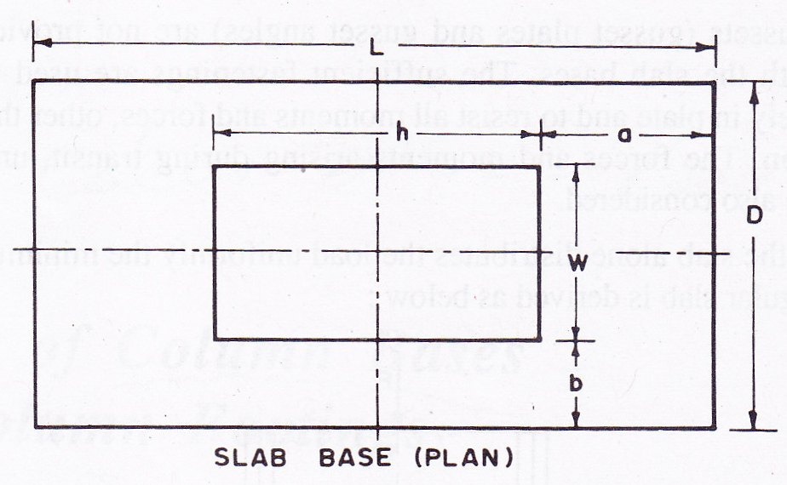

Slide 95
.
The column is carrying an axial load P. Consider the load distributed over area h x w and under the slab over the area L x D as shown in Fig. 12.2.
Let t=Thickness of the slab
W=Pressure or loading on the underside of the base
a=Greater projection beyond column
b=Lesser projection beyond column
σ_{bs}= Allowable bending stress in the slab bases for all steels, it shall be assumed as 185 N/mm²
Consider a strip of unit width.
Along the xx-axis
Along the yy-axis

Slide 96
.
If Poison ratio is adopted as ¼ the effective moment for width D =
Effective moment for width L
Since a is greater projection from the column, the effective moment for width D is more. Moment of resistance of the slab base of unit width

Slide 97
.
Where t= Thickness of plate in mm
W=Total axial load in kN
B=Length of the side of base of cap in mm
d₀=Diameter of the reduced end (if any) of the column in mm
σ_{bs}= Allowable bending stress in steel (is adopted as 185 N/mm²)
The allowable intensity of pressure on concrete may be assumed as 4 N/mm². When the slab does not distribute the load uniformly or where the slab is not rectangular, separate calculation shall be made to show that stresses are within the specified limits.
When the load on the cap or under the base is not uniformly distributed or where end of the column shaft is not machined with the cap or base, or where the cap or base is not square in plan, the calculations are made on the allowable stress of 185 N/mm² (MPa). The cap or base plate shall not be less than 1.50 (d_{o}+75) mm in length or diameter.

Slide 98
.
The area of the shoulder (the annular bearing area) shall be sufficient to limit the stress in bearing, for the whole of the load communicated to the slab to the maximum value 0.75 f_{y} and resistance to any bending communicated to the shaft by the slab shall be taken as assisted by bearing pressures developed against the reduced and of the shaft in conjunction with the shoulder.
The bases foe bearing upon concrete or masonry need not be machined on the underside provided the reduced end of the shaft terminate short of the surface of the slab and in all cases the area of the reduced end shall be neglected in calculating the bearing pressure from the base.
In cases where the cap or base is fillet welded direct to the end of the column without boring and shouldering, the contact surfaces shall be machined to give a perfect bearing and the welding shall be sufficient to resist transmitting the forces specified above. Where the full length T butt welds are provided no machining of contact surfaces shall be required.

Slide 99
FOUNDATION BOLTS
Foundation bolts are mainly used in pre-engineered buildings manufacturing, fastening heavy machines to foundations,and construction. They are also used in process-based businesses like petrochemical, sugar, and FMCG manufacturing.
It is mostly used for industrial purposes and therefore made with heavy duty stainless steel or carbon steel.
Foundation bolts are mostly used to set machines on concrete floorings.
Initially, the position of the bolts is marked on the ground. Then, dimensionally accurate holes are dug in their exact positions. The bolts are then suspended on their respective holes and the concrete is poured around it. Once the concrete sets, the suspensions are removed and the machine is installed.

Slide 100
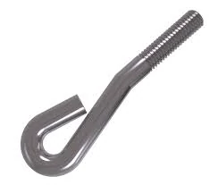
TYPES OF FOUNDATION BOLTS
EYE FOUNDATION BOLT
The eye foundation bolt has one end of it forged to bend and look like an eye. The eye-end also has a cross piece fixed in it for the setting of the machine. These bolts are used to securely hold industrial grade cables which need to be able to withstand strong movements, winds and pressure.

Slide 101
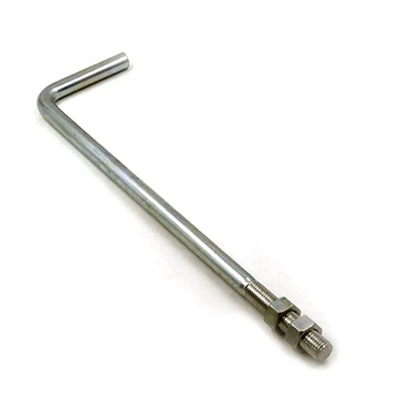
L/J FOUNDATION BOLT
These foundation bolts are used to hold together significantly heavy support structures. They mostly find their application in electrical and cell phone towers. Depending on the required tensile strength, these bolts can be manufactured in various grades of stainless steel.

Slide 102
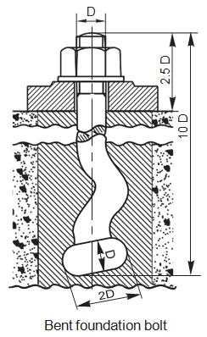
BENT FOUNDATION BOLT
These bolts feature a signature bend on one end and can be set in either concrete or stone beds. The bolts are initially set in lead and then the whole assembly is set in concrete for improved hold. To secure the base of the machines in place, an industry-grade screw is used. The bend on the lower end results in a firmer grip.

Slide 103
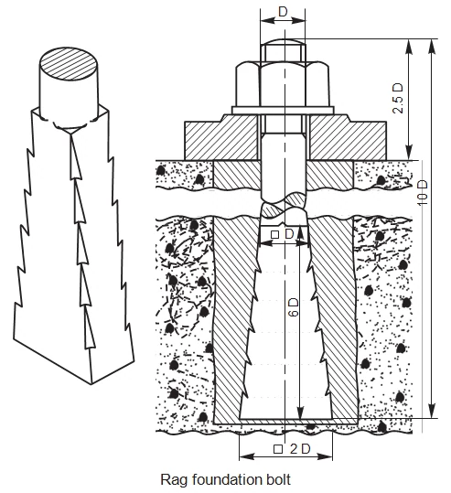
RAG FOUNDATION BOLT
This unique foundation bolt has a tapered body which comes with grooves on all sides of its body and a square or rectangular cross-section. Similar to the bent foundation bolt, it is mandatory to first allow the rag bolts to set in lead before allowing the whole assembly to set in concrete.

Slide 104
LEWIS FOUNDATION BOLT
Lewis foundation bolts are tapered in width on one side and come with keys which allow it to be removed with ease. Therefore, these bolts are used predominantly for lifting and moving huge blocks of stones instead of fastening machines to a foundation.
To use this bolt, a foundation block is used to create a pit in cement concrete. Once the concrete sets in, the Lewis foundation bolt is placed inside it with the tapered side of the bolt facing the tapered face of the pit. On the straight faces of the bolt and the pit, a key is inserted to enable the removing of the bolt.

Slide 105
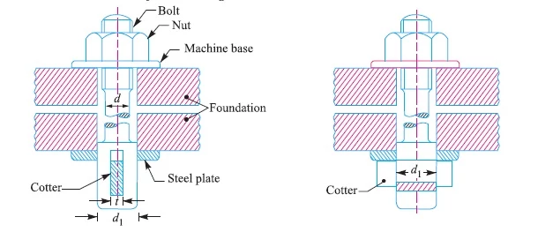
COTTER FOUNDATION BOLT
These bolts are used specifically for installing heavy machinery in place. The bolt has a rectangular slot in the bottom to facilitate the insertion of the cotters. Please note that a washer has to be used to act as the bearing surface for the cotter.

Slide 106
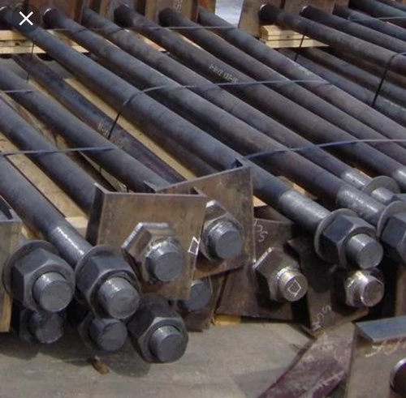
PLATE TYPE FOUNDATION BOLT
A very popular bolts types of foundation bolts, the plate type foundation bolt comes with a housing plate on one end and heavy-duty threadings on the other end. This is popularly used in the construction industry.

Slide 107
UNIT-4
DESIGN OF BEAMS

Slide 108
CONTENT
Design of beams
Types of cross section
Lateral stability of beams
Lateral torsional buckling
Bending and shear strength
Web buckling
Web crippling
Deflection
Design procedure

Slide 109
Design of beams

Slide 111
Types of cross section

Slide 112
Lateral torsional buckling
Stability of Beams
Laterally Unrestrained Beams
Laterally Restrained Beams
Lateral-torsional Buckling in Beams

Slide 113
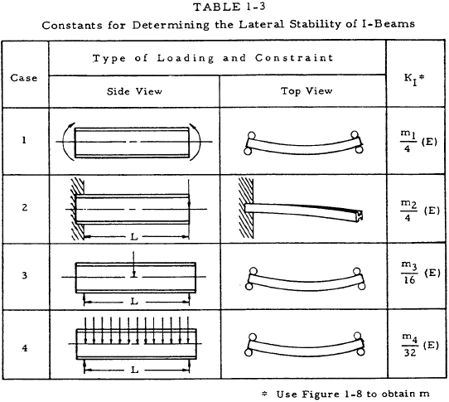

Slide 117
Difference between Bending stress and shear stress
BENDING STRESS
SHEAR STRESS
Bending stress is act on perpendicular to the Plane of cross.
Bending stress is varies Linearly over the depth Of beam.
Bending stress is zero On neutral axis.
Bending stress is maximum at extreme fiber .
Stress si unit is N/ mm²
Bending stress is depend on bending moments
Shear stress is act on Parallel to the plane of cross section of beam.
Shear stress is varies parabolically over the depth of beam.
Shear stress have value On neutral axis. Shear Stress is not zero on neutral axis.
Shear stress is zero on extreme fiber.
Strain has no unit
Shear stress is depend On shear force or Parallel force.

Slide 120
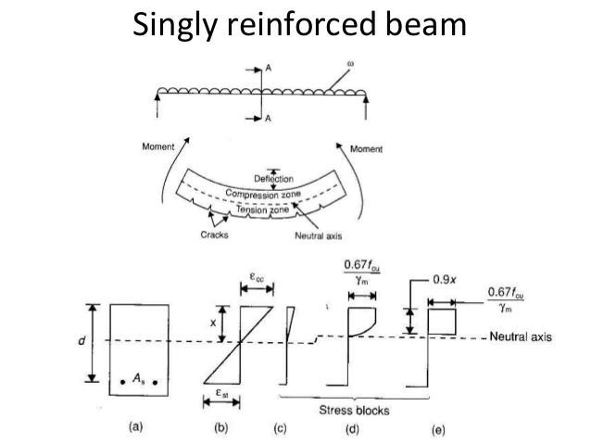

Slide 124
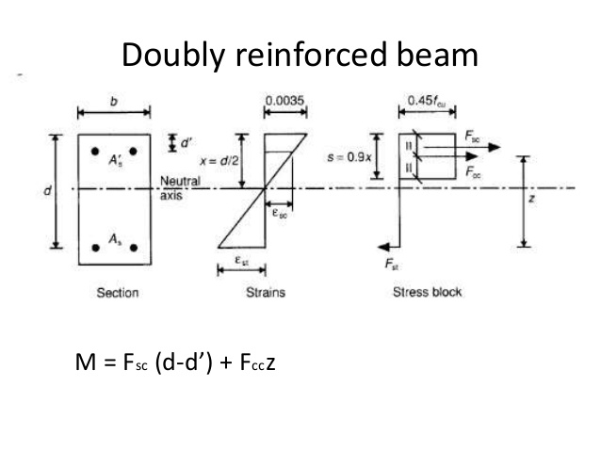

Slide 142
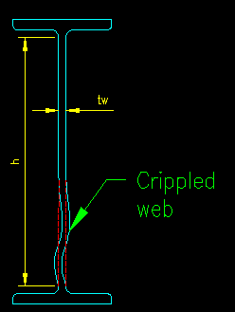
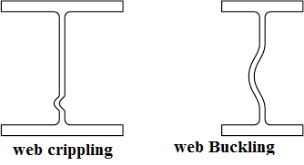
Web crippling
Web crippling is actually local buckling that occurs when the web is slender (i.e. h/t_{w} is large). Figure 8.5.2.1 is a rough illustration of the behavior being considered. The behavior is more restrained when the point load is applied away from the ends of the member, consequently there are separate equations for when a concentrated transverse load is locate near or away from the end of the member.
This limit state is to be checked at each location where a concentrated force is applied transverse to the axis of a member.

Slide 143
.
Web Plate
The amount of steel and the size of the web plate, which is the supporting structure in a girder, beam or truss, is crucial to determining the probability of web crippling. Mathematical design equations must be performed prior to construction to determine the amount of steel to prevent this problem.
Calculations
Six parameters comprise American and Canadian web-crippling capacity calculations. These are thickness of the web, strength of the material, ratio of inside bend radius to web thickness, ratio of flat portion of the web to thickness, ratio of bearing length to thickness and the inclination of the web element. Four different loading conditions--end and interior one-flange loading and end and interior two-flange loading--are also computed.
Localized Failure
Web crippling is a localized, incomplete failure because the steel plate is still able to withstand yield loads even though the structure becomes buckled. This failure, however, can contribute to overall building collapse.

Slide 144
UNIT-5
PLATE GIRDERS

Slide 145
CONTENT
Plate girder
Various elements
Design components of moment connection
Roof trusses

Slide 146
Plate girder
A plate girder is a type of beam built from plates of steel that are either bolted or welded together.
The plate girders are typically I-beams made up from separate structural steel plates which are welded or, bolted or riveted together to form the deep vertical web with a pair of angles each edge to act as compression and tension flanges.
Plate girders became popular in the late 1800's, when they were used in construction of railroad bridges.
By 1950's welded plate girders replaced riveted and bolted plate girders.
The purpose of the plate girder is to build a beam that is larger than anything that can be built by a steel mill or factory.
The size and shape of the girder allows builders to construct structures that are much longer and heavier duty.
Plate girders are usually prefabricated and the length limit is frequently set by the mode of transportation.

Slide 147
Components of Plate Girder
The components of typical plate girder are as follows :
Web
Flanges
Stiffeners

Slide 148
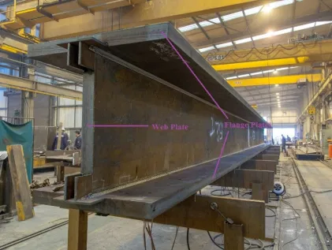
1. Web
The deep central vertical plate is called as a web in plate girder. It separates the two flange plates by a required distance. Web is responsible to resist shear developed in the plate girder.

Slide 149
2. Flanges
Flanges or flange plates are horizontal elements of plate girder which are provided at the top and bottom and they are separated by the web.
The main purpose of flange plates is to resist the bending moment acting on the girder.
The top flange resists the bending moment by developing compression and the bottom flange resists the tensile force. They should be provided with a required width and thickness to offer good resistance against bending moment.

Slide 150
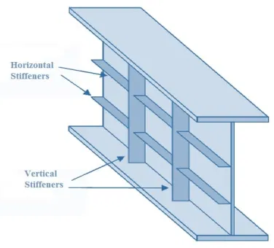
3. Stiffeners
Stiffeners are classified into two types :
Vertical Stiffeners
Horizontal Stiffeners

Slide 151
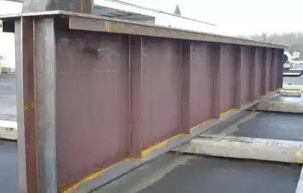
Vertical Stiffeners
Vertical stiffeners are provided at right angles to the flanges and they are also called as transverse stiffeners.
These are again classified into two types namely end stiffeners and intermediate stiffeners based on their position in the plate girder.
End stiffeners are provided at both the ends of the girder. They receive the load from the beam and transfer it to the support. End stiffeners are also called as bearing stiffeners.
Intermediate stiffeners are required when there are concentrated loads acting on the plate girder. When the thickness of the web is very less (less than 1/85th of the depth of the web), then the web may buckle due to shear. intermediate stiffeners are provided in order to improve the buckling strength of the web.

Slide 152
Horizontal Stiffeners
Horizontal stiffeners are provided in parallel to the flange plates. They are also called as longitudinal stiffeners.
These stiffeners will improve the buckling strength of the web portion. Horizontal stiffeners are either continuous or discontinuous.
Continuous horizontal stiffeners connect all the traverse stiffeners and also take load coming from the flange and web portions.
Discontinuous horizontal stiffeners are provided between the traverse stiffeners without touching them.
They do not take any load coming from the flange or web portion, they just provide buckling resistance to the web.

Slide 153
Design components of eccentric & moment connection
Moment resisting connections are used in multi- storey un-braced buildings and in single-storey portal frame buildings. Connections in multi- storey frames are most likely to be bolted, full depth end plate connections or extended end plate connections. Where a deeper connection is required to provide a larger lever-arm for the bolts, a hunched connection can be used. However, as extra fabrication will result, this situation should be avoided if possible.
For portal frame structures, hunched moment resisting connections at the eaves and apex of a frame are almost always used, as in addition to providing increased connection resistances, the haunch increases the resistance of the rafter.
Moment connections are designed to transfer bending moments, shear forces and sometimes normal forces.
The most commonly used moment resisting connections are bolted end plate beam-to-column connections; these are shown in the figure below.

Slide 154
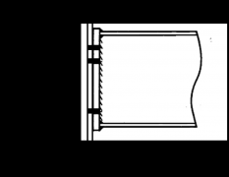
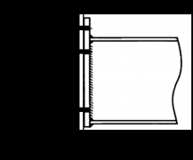
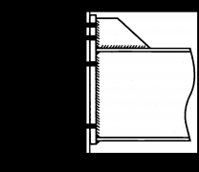
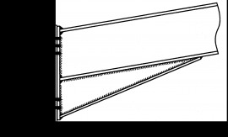
.
Full depth end plate
Extended end plate
Stiffened extended end plate
Haunched beam

Slide 155
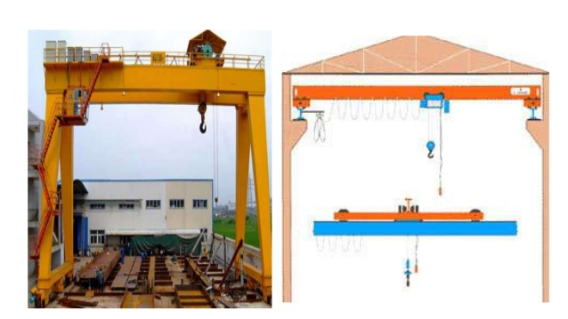

Slide 156
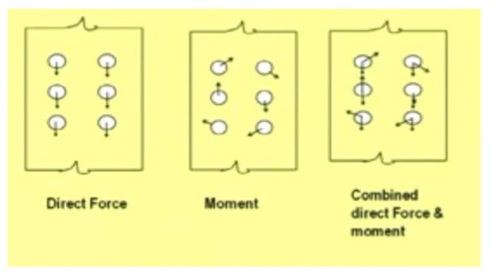

Slide 165
Roof Truss
In Structural Engineering, the name “truss” describes a triangular design. A joint framed structure that sustained the inclined, vertical or horizontal loads. A truss consist of angles, channels, plates and eye bars. It is a framework, typically consisting of rafters, posts, and struts, supporting a roof, bridge or other structure. You will find them supporting the roofs of auditoriums, cinema halls, stadiums, railways, stations, airports and others.
A roof truss is considered the most important key component in engineering system in a building. They serve a critical function and design depends on various factors. Without roof, buildings would be exposed to all kinds of elements, rendering them completely useless. Here are some of the benefits of installing a roof truss.

Slide 166
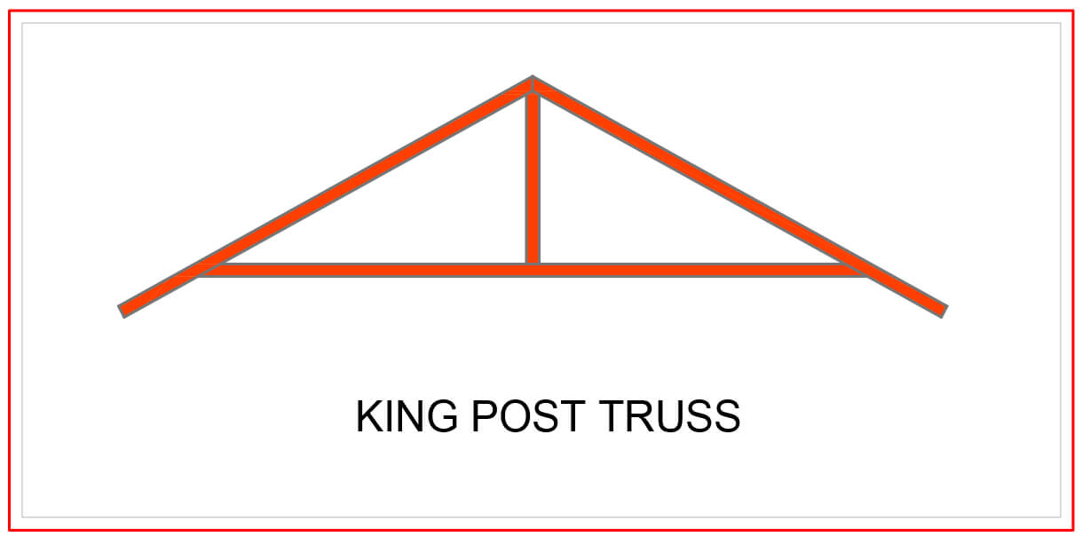
Different Types of Roof Trusses
King Post Truss
Central vertical post used in architectural, working in tension to support a beam below from a truss apex. This truss usually spans up to 8 meters, which makes it perfect for multiple types of houses, especially the smaller ones.

Slide 167
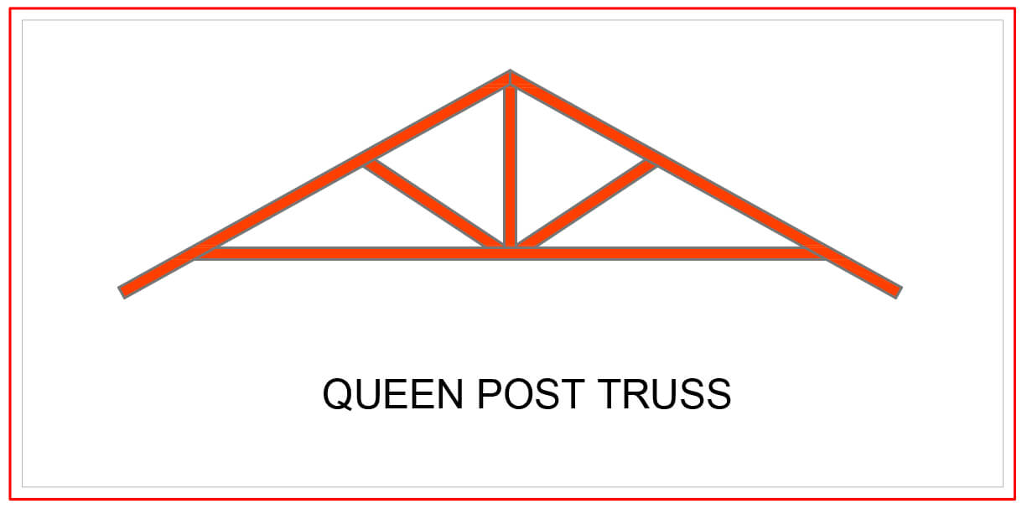
Queen Post Truss
A very reliable, simple and versatile type of roof truss where you can use at any given time. This kind of truss offers a span of around 10 meters, and has a simple design which makes it perfect for a wide range of establishments.

Slide 168
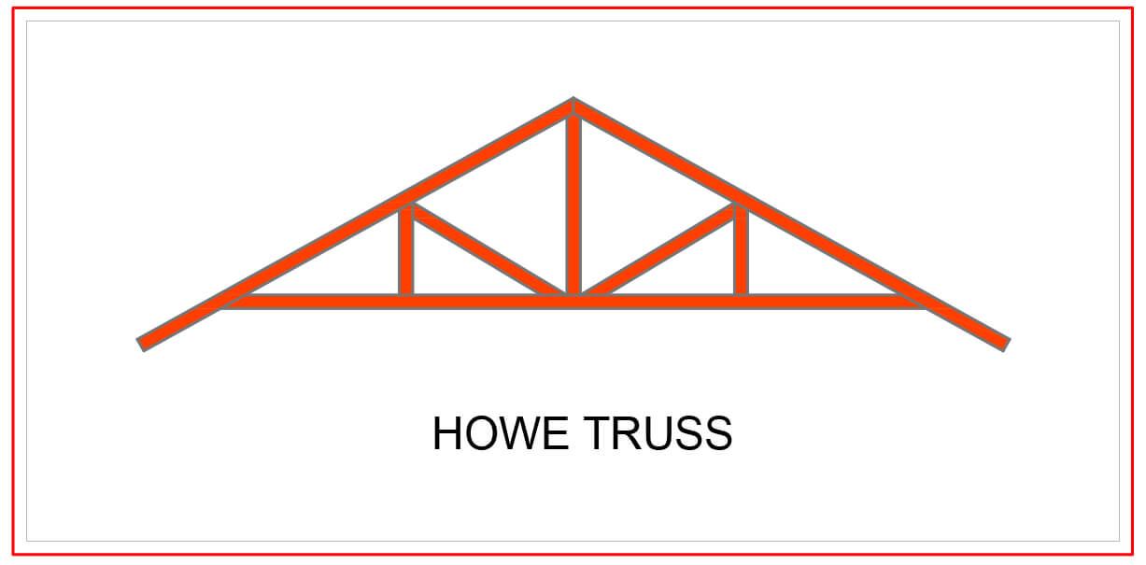
Howe Truss
A kind of truss having upper and lower members, a combination of steel and wood or both. One thing that makes this truss extraordinary is that it has a very wide span, as it can cover anything from 6-30 meters. This is very useful for a wide range of project types.

Slide 169
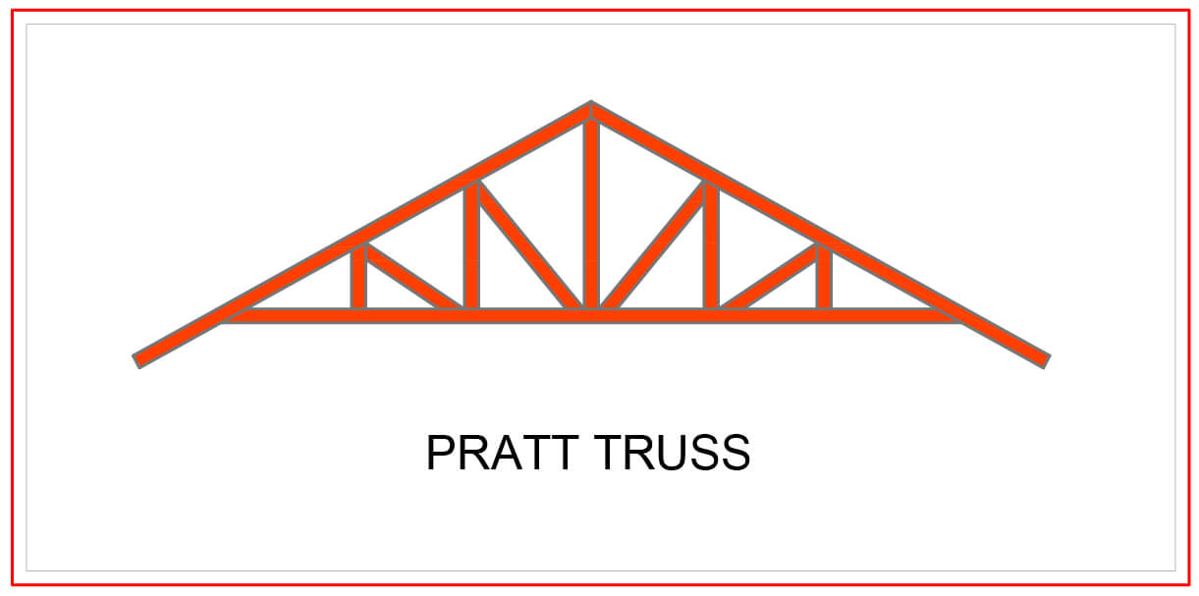
Pratt Truss
The prat truss is the most popular steel truss since it is very economical. It includes vertical and diagonal members that slope down towards the center (opposite of Howe Truss). Pratt truss can cover lengths ranging between 6-10 meters.

Slide 170
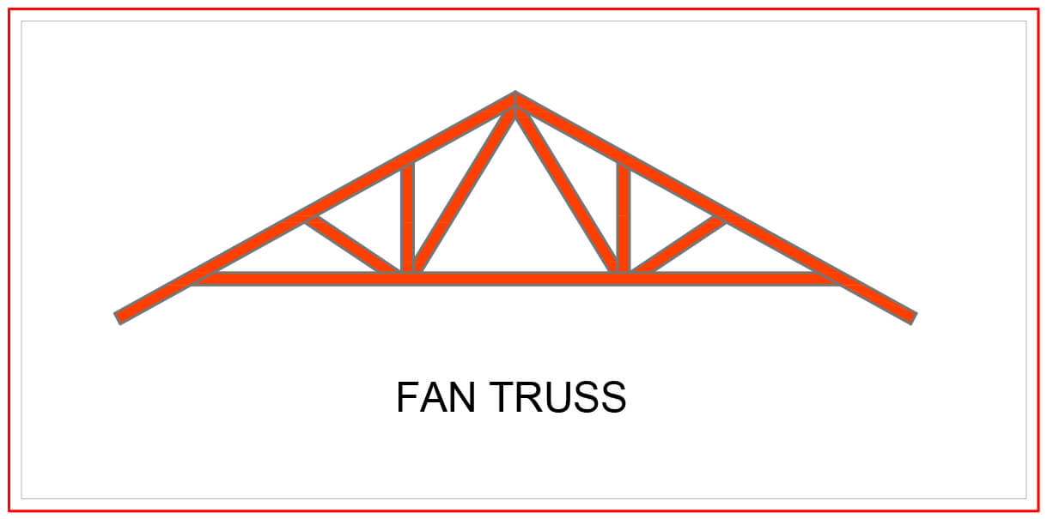
Fan Truss
A simple design made out of steel. Most projects with larger span of around 10-15 meters uses this kind of truss.

Slide 171
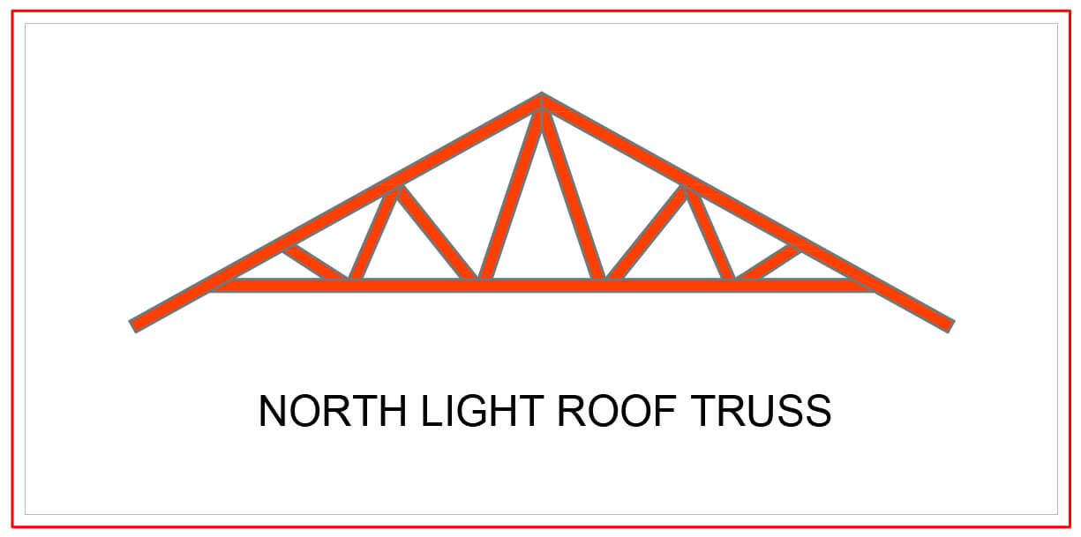
North Light Roof Truss
Have a wide set of lattice girders that include support trusses. North light truss is the oldest, and most economical kind of truss. These are found in industrial buildings, drawing rooms and large spaces, with a span of 20-30 meters.

Slide 172
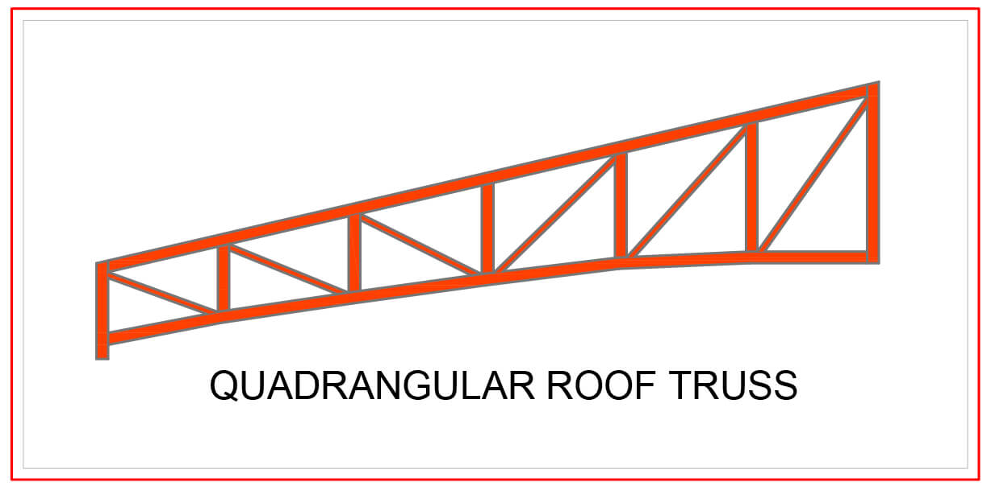
Quadrangular Roof Trusses
Type of truss having parallel chords and an arrangement of web members of tension diagonals and compression verticals. It is mostly encountered in auditoriums or railway sheds.

Slide 173
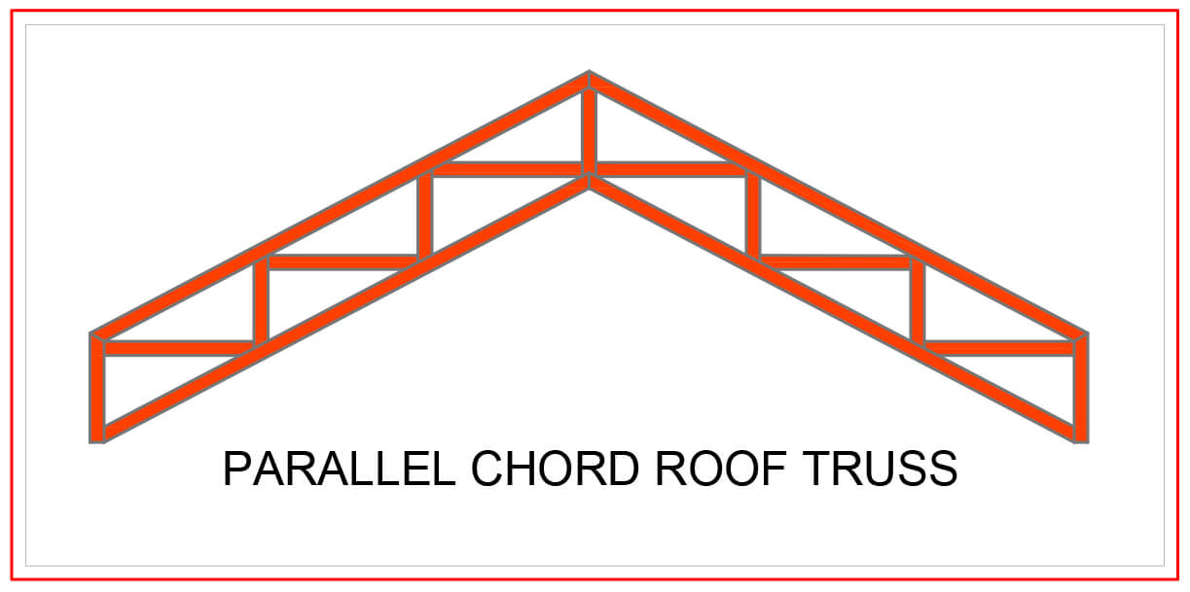
Parallel Chord Roof Truss
Constructed with two chords running parallel to each other and supported by reinforcing trusses in between the top and bottom chords. This roof truss reduces the condensation problems and mold conditions since they create a vapor barrier.

Slide 174
Raised Heel Roof Truss
Provides a cost-effective way to meet more stringent energy efficiency codes and improve the energy efficiency of your building envelope. Raising the truss higher greatly simplifies attic ventilation and it leaves ample room for insulation above exterior wall top plates

Slide 175
Scissor Roof Truss
The bottom chord members cross each other, connecting to the angled top chords at a point intermediate on the top chords’ length, creating an appearance similar to an opened pair of scissor. A scissor truss provides for a vaulted ceiling in the same time frame as standard trusses. Cathedral is one of the best example of this kind of truss.

Slide 176
The Basic Components of a Roof Truss
Apex – Highest point where the sloping top chords meet.
Bearing – Structural support of trusses (usually walls) normally with a timber wall plate.
Bottom Chords (BC) – the lowest longitudinal member of a truss.
Cantilever – part of structural member that extends beyond its support.
Cantilever Strut – web that joins the bottom chord above the bearing point to the top chord of a cantilevered truss.
Chord – main members that form the outline of the truss and subject to relatively large axial forces and bending moments.
Clear Span – horizontal distance between interior edges of supports.
Heel – point on a truss which top and bottom chord intersect.
Joint – point of intersection of one or more web(s) with a chord.
Nail Plate – galvanized steel plate punched to form a nail pattern integral with the plate and used to connect timber members.
Node (node point) – point of intersection of two or more members that make up the panels of a truss.
Nominal Span – horizontal distance between outside edges of the supports (wall plates) – usually the tie beam length.

Slide 178
.
Overhang – extension of the top chord of a truss beyond the bearing support.
Panel – truss segment defined by two adjacent joints or nodes.
Plumb Cut – vertical cut to the end of the top chord to provide for vertical (plumb) installation of the fascia or gutter
Splice Point – Top and bottom chord splice
Square Cut – perpendicular to the edges of the chord
Stub End – a truss type formed by the truncation of a normal triangular truss.
Top Chord or Rafter – a horizontal member that establishes the upper edge of a truss
Web – members that join the top and bottom chords to form a triangular pattern

Slide 180
THANK YOU

