Slide 1
Branch-CSE
6th sem B.Tech
Unit-3
Coding and Testing
Subject-Software Engineering

Slide 2
🞂
Topics
Code review
Code Walk through
Code Inspection
Software Documentation
Internal Documentation
External Documentation
Testing
Unit Testing
Black-box Testing
White-box testing
Test Documentation
Notes:
Major Learning Outcomes

Slide 3
Coding
Coding is under taken once the design phase is complete and the design document have been successfully reviewed.
The coding is the process of transforming the design of a system into a computer language format.
In the coding phase , every module identified and specified in the design document is independently Coded and Tested
The input to the coding phase is Design document.
Coding is done by the coder or programmers who are independent people than the designer.
So the objective of the coding phase is to transform the design of a system into a high level language code and to unit test this code.
Notes:
Coding

Slide 4
Good software development organizations usually develop their own coding standards and guidelines depending on what best suits their organization and the type of products they develop.
The following are some representative coding standards:-
Rules for limiting the use of global: These rules list what types of data can be declared global and what cannot.
Contents of the headers preceding codes for different modules: The information contained in the headers of different modules should be standard for an organization.
It is very important for the programmers to maintain the coding standards otherwise the code will be rejected during code review.
It improves readability, and maintainability of the code and it reduces complexity also.
It helps in code reuse and helps to detect error easily.

Slide 5
The exact format in which the header information is organized in the header can also be specified.
The following are some standard data for coding:-
Name of the module.
Date on which the module was created.
Author’s name.
Modification history.
Different functions supported, along with their input/output parameters.
Global variables accessed/modified by the module. Naming conventions for global variables, local variables, and constant identifiers.
A possible naming convention can be that global variable names always start with a capital letter, local variable names are made of small letters, and constant names are always capital letters.

Slide 6
Error return conventions and exception handling mechanisms.
The way error conditions are reported by different functions in a program are handled should be standard within an organization.
For example, different functions while encountering an error condition should either return a 0 or 1 consistently.
Do not use a coding style that is too clever or too difficult to understand: Code should be easy to understand. Clever coding can uncertain meaning of the code and Difficult to understand. It also makes maintenance difficult.
Avoid uncertain side effects: any part of code should not be affect the other part of the code. Uncertain side effects make it difficult to understand a piece of code.
Do not use an identifier for multiple purposes: Programmers often use the same identifier to denote some temporary entities.
Use of a variable for multiple purposes can lead to confusion and make it difficult for somebody trying to read and understand the code.

Slide 7
The code should be well-documented : there must be at least one comment line on the average for every three-source line.
The length of any function should not exceed 10 source lines: A function that is very lengthy is usually very difficult to understand as it probably carries out many different functions. lengthy functions are likely to have larger number of bugs.
Do not use goto statements: Use of goto statements makes a program unstructured and makes it very difficult to understand.

Slide 8
Code Review
Code review for a model is carried out after the module is successfully compiled and the all the syntax errors have been eliminated.
Code reviews are extremely cost-effective strategies for reduction in coding errors and to produce high quality code.
Normally, two types of reviews are carried out on the code of a module.
These two types code review techniques are code inspection and code walk through.

Slide 9
Code Review is a systematic examination, which can find and remove the vulnerabilities in the code such as memory leaks and buffer overflows.
Technical reviews are well documented and use a well-defined defect detection process that includes peers and technical experts.
It is ideally led by a trained moderator, who is NOT the author.
This kind of review is usually performed as a peer review without management participation.
Reviewers prepare for the review meeting and prepare a review report with a list of findings.
Technical reviews may be quite informal or very formal and can have a number of purposes but not limited to discussion, decision making, evaluation of alternatives, finding defects and solving technical problems.

Slide 10
Code walk through is code analysis technique. This technique applied , after a module has been coded, successfully compiled and all syntax errors eliminated.
A few members of the development team are given the code few days before the walk through meeting to read and understand code.
Each member selects some test cases and simulates execution of the code by hand (i.e. trace execution through each statement and function execution).
The main objectives of the walk through are to discover the algorithmic and logical errors in the code.
The members note down their findings to discuss these in a walkthrough meeting where the coder of the module is present.

Slide 11
Some of the guidelines for Code Walkthrough are the following.
1.The team performing code walk through should not be either too big or too small. Ideally, it should consist of between three to seven members.
2.Discussion should focus on discovery of errors and not on how to fix the discovered errors.
3.Managers should not attend the walk through meetings.

Slide 12
In contrast to code walk through, the aim of code inspection is to discover some common types of errors caused due to oversight and improper programming.
In other words, during code inspection the code is examined for the presence of certain kinds of errors.
Good software development companies collect statistics regarding different types of errors commonly committed by their engineers and identify the type of errors most frequently committed.
Such a list of commonly committed errors can be used during code inspection to look out for possible errors.

Slide 13
Following is a list of some classical programming errors which can be checked during code inspection:
1. Use of uninitialized variables.
2. Jumps into loops.
3. Non terminating loops.
4. Incompatible(contradiction) assignments.
5. Array indices out of bounds.
6. Improper storage allocation and deallocation.
7. Mismatches between actual and formal parameter in procedure calls.
8. Use of incorrect logical operators or incorrect precedence among operators.
9. Improper modification of loop variables.

Slide 14
Software Documentation
Software documentation is written text or illustration that accompanies computer software or is embedded in the source code.
When various kinds of software products are developed then not only the executable files and the source code are developed but also various kinds of documents such as:-
1.users’ manual
2.software requirements specification (SRS) documents
3.design documents
4.test documents
5.installation manual, etc are also developed as part of any software engineering process.
All these documents are a vital part of good software development practice. Good documents are very useful and used for the following purposes:

Slide 15
Good documents enhance understandability and maintainability of a software product. They reduce the effort and time required for maintenance.
User documents help the users in effectively using
the system.
Good documents help in effectively handling the manpower turnover problem. Even when an engineer leaves the organization, and a new engineer comes in, he can build up the required knowledge easily.
Production of good documents helps the manager in effectively tracking the progress of the project.
The project manager knows that measurable progress is achieved if a piece of work is done and the required documents have been produced and reviewed.

Slide 16
1. Internal documentation
2. External documentation
Internal documentation is the code understanding features provided as part of the source code itself. Internal documentation is provided through appropriate module headers and comments in the source code.
Internal documentation is also provided through the useful variable names, module and function headers, code structuring, use of enumerated types and constant identifiers, use of user-defined data types, etc.
Careful experiments suggest that out of all types of internal documentation meaningful variable names is most useful in understanding the code.

Slide 17
code commenting is also very useful.
For example, the following style of code commenting does not in any way help in understanding the code.
a = 10; /* a made 10 */
But even when code is carefully commented, meaningful variable names still are more helpful in understanding a piece of code.
Good software development organizations usually maintain good internal documentation.
External documentation is provided through various types of supporting documents such as users’ manual, software requirements specification document, design document, test documents, etc.
A systematic software development style ensures that all these documents are produced in an orderly fashion.

Slide 18
Testing a program consists of providing the program with a set of test inputs (or test cases) and observing if the program behaves as expected.
If the program fails to behave as expected, then the conditions under which failure occurs are noted for later debugging and correction.
Some commonly used terms associated with testing are:
Failure: This is a result of an error (or defect or bug). the
presence of an error may not necessarily lead to a failure.
Test case: This is the triplet [I,S,O], where I is the data input to the system, S is the state of the system at which the data is input, and O is the expected output of the system.
Test suite: This is the set of all test cases with which a given
software product is to be tested.

Slide 19
Purpose of Testing
The aim of the testing process is to identify all defects existing in a software product. However for most practical systems, even after carrying out the testing phase, it is not possible to guarantee that the software is error free.
This is because of the fact that the input data domain of most software products is very large. It is not practical to test the software with respect to each value that the input data may assume.
Even with this practical limitation of the testing process, the importance of testing should not be underestimated. It must be remembered that testing does expose many defects existing in a software product.
Thus testing provides a practical way of reducing defects in a system and increasing the users’ confidence in a developed system.

Slide 20
Verification is the process of determining whether the output of one phase of software development conforms to that of its previous phase, whereas validation is the process of determining whether a fully developed system conforms to its requirements specification.
Thus while verification is concerned with errors in phase, the aim of validation is that the final product be error free.
Verification is the process of checking that a software achieves its goal without any bugs. Validation is the process of checking whether the software product is up to the mark or in other words product has high level requirements.
Both are used to finds a defect in different way, Verification is used to identify the errors in requirement specifications & validation is used to find the defects in the implemented Software application.

Slide 21
In the black-box testing approach, test cases are designed using only the functional specification of the software, i.e. without any knowledge of the internal structure of the software. For this reason, black-box testing is known as functional testing.
On the other hand, in the white-box testing approach, designing test cases requires thorough knowledge about the internal structure of software, and therefore the white-box testing is called structural testing.

Slide 22
Software products are normally tested first at the individual component (or unit) level. This is referred to as testing in the small.
After testing all the components individually, the components are slowly integrated and tested at each level of integration (integration testing).
Finally, the fully integrated system is tested (called system testing). Integration and system testing are known as testing in the large.

Slide 23
Unit testing is undertaken after a module has been coded and successfully reviewed. Unit testing (or module testing) is the testing of different units (or modules) of a system in isolation.
In order to test a single module, a complete environment is needed to provide all that is necessary for execution of the module. That is, besides the module under test itself, the following steps are needed in order to be able to test the module:
1. The procedures that the module under test calls.
2. Nonlocal data structures that the module accesses.
3. A procedure to call the functions of the module.
Modules required to provide the necessary environment (which either call or are called by the module under test) is usually not available until they too have been unit tested.
Stubs and drivers are designed to provide the complete environment for a module.
.

Slide 24
A driver module contain the nonlocal data structures accessed by the module under test, and would also have the code to call the different functions of the module with appropriate parameter values.
A stub procedure is a dummy procedure that has the same I/O parameters as the given procedure.

Slide 25
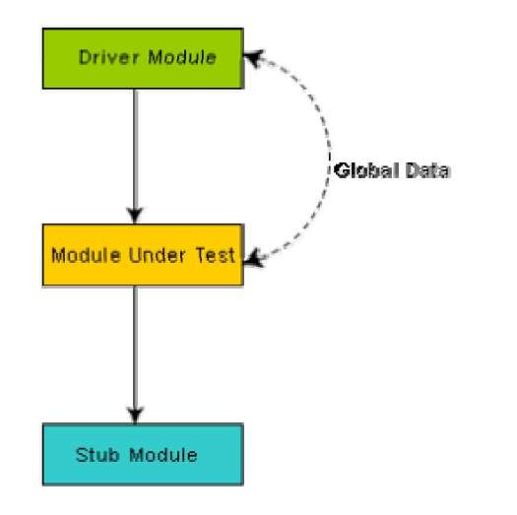

Slide 26
In the black-box testing, test cases are designed from an examination of the input/output values only and no knowledge of design, or code is required.
The following are the two main approaches to designing black box test cases.
Equivalence class portioning
Boundary value analysis

Slide 27
Equivalence Classes
In this approach, the domain of input values to a program is partitioned into a set of equivalence classes.
This partitioning is done such that the behavior of the program is similar for every input data belonging to the same equivalence class.
Equivalence classes for a software can be designed by examining the input data and output data.
The following are some general guidelines for designing the equivalence classes:
If the input data values to a system can be specified by a range of values, then one valid and two invalid equivalence classes should be defined.
If the input data assumes values from a set of discrete members of some domain, then one equivalence class for valid input values and another equivalence class for invalid input values should be defined.

Slide 28
Example : For a software that computes the square root of an input integer which can assume values in the range of 0 to 5000, there are three equivalence classes:
1. The set of negative integers
2. The set of integers in the range of 0 and 5000
3. The integers larger than 5000.
Therefore, the test cases must include values for each of the three equivalence classes and a possible test set can be: {-5,500,6000}.

Slide 29
A type of programming error frequently occurs at the boundaries of different equivalence classes of inputs.
Boundary Value Analysis is a Black-Box testing technique used to check the errors at the boundaries of an input domain.
The name comes from the Boundary, which means the limits of an area.
For example, programmers may improperly use <instead of <=, or <= for <.
Boundary value analysis leads to selection of test cases at the boundaries of the different equivalence classes.
Example: For a function that computes the square root of integer values in the range of 0 and 5000,
The test cases must include the following values:
{0, -1,5000,5001}.

Slide 30
White Box Testing is software testing technique in which internal structure, design and coding of software are tested to verify flow of input-output and to improve design, usability and security.
One white-box testing strategy is said to be stronger than another strategy, if all types of errorsdetected by the first testing strategy is also detected by the second testing strategy, and the second testing strategy additionally detects some more types of errors.
When two testing strategies detect errors that are different at least with respect to some types of errors, then they are called complementary.
In white box testing, code is visible to testers so it is also called Clear box testing, Open box testing, Transparent box testing, Code-based testing and Glass box testing.

Slide 31
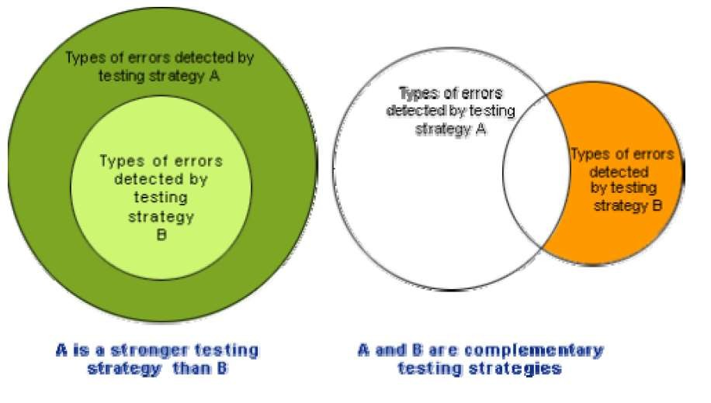

Slide 32
The statement coverage strategy aims to design test cases so that every statement in a program is executed at least once.
Unless a statement is executed, it is very hard to
determine if an error exists in that statement.
However, executing some statement once and observing that it behaves properly for that input value is no guarantee that it will behave correctly for all input values.
For ex. Int x,y;
If (x>y)
Printf(“x is grater”);
Else
Printf(“y is grater”);
For this code test case should be {(5,4),(4,5)}.

Slide 33
Example….
int compute_gcd(x, y) int x, y;
{
1 while (x! = y){ 2 if (x>y) then 3 x= x – y;
4 else y= y – x;
5 }
6 return x;
}
By choosing the test set {(x=3, y=3), (x=4, y=3), (x=3, y=4)}, we can exercise the program such that all statements are executed at least once.

Slide 34
In the branch coverage-based testing strategy, test cases are designed to make each branch condition to assume true and false values in turn.
Branch testing is also known as edge testing as in this testing scheme, each edge of a program’s control flow graph is traversed at least once.
It is obvious that branch testing guarantees statement coverage and thus is a stronger testing strategy compared to the statement coverage- based testing.
For GCD algorithm , the test cases for branch coverage can be {(x=3, y=3), (x=3, y=2), (x=4, y=3), (x=3, y=4)}.

Slide 35
In this structural testing, test cases are designed to make each component of a composite conditional expression to assume both true and false values.
For example, in the conditional expression ((c1.and.c2).or.c3), the components c1, c2 and c3 are each made to assume both true and false values.
Condition testing is a stronger testing strategy than branch testing and branch testing is stronger testing strategy than the statement coverage-based testing.
For a composite conditional expression of n components, for condition coverage, 2ⁿ test cases are required.
Thus, for condition coverage, the number of test cases increases exponentially with the number of component conditions.
Therefore, a condition coverage-based testing technique is practical only if n (the number of conditions) is small.

Slide 36
The path coverage-based testing strategy requires us to design test cases such that all linearly independent paths in the program are executed at least once. A linearly independent path can be defined in terms of the control flow graph (CFG) of a program.
A path through a program is a node and edge sequence from the starting node to a terminal node of the control flow graph of a program.
A linearly independent path is any path through the program that introduces at least one new edge(new node) that is not included in any other linearly independent paths.

Slide 37
A control flow graph describes the sequence in which the different instructions of a program get executed. In other words, a control flow graph describes how the control flows through the program.
In order to draw the control flow graph of a program, all
the statements of a program must be numbered first.
The different numbered statements serve as nodes of the control flow graph.
An edge from one node to another node exists if the execution of the statement representing the first node can result in the transfer of control to the other node.
The CFG for any program can be easily drawn by knowing how to represent the sequence, selection, and iteration type of statements in the CFG.
After all, a program is made up from these types of statements.

Slide 38
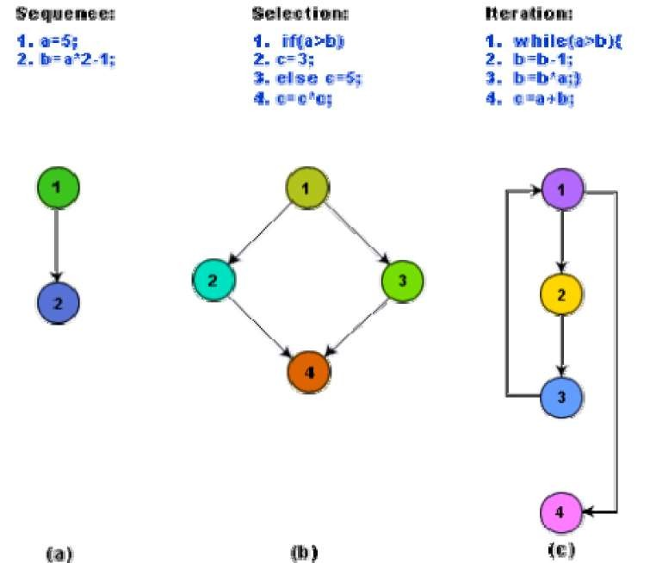

Slide 39
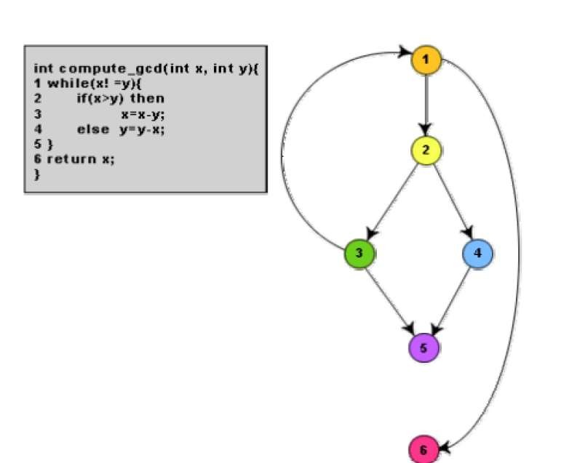

Slide 40
For more complicated programs it is not easy to determine the number of independent paths of the program.
McCabe’s cyclomatic complexity defines an upper bound for the number of linearly independent paths through a program.
McCabe’s metric does not directly identify the linearly independent paths, but it informs approximately how many paths to look for.
There are three different ways to compute the cyclomatic complexity. The answers computed by the three methods are guaranteed to agree.

Slide 41
Method 1: Given a control flow graph G of a program, the cyclomatic complexity V(G) can be computed as:
V(G) = E – N + 2
where N is the number of nodes and E is the edges
For the CFG of above example, E=7 and N=6. Therefore, the cyclomatic complexity = 7-6+2 = 3.
Method 2:
V(G) = Total number of bounded areas + 1
In the program’s control flow graph G, any region enclosed by nodes and edges can be called as a bounded area.
This method used only for structured program (planer graph) and not used for non-structured program(non planer graph)

Slide 42
The number of bounded areas increases with the number of decision paths and loops.
For the CFG of above example , number of bounded areas is 2. Therefore the cyclomatic complexity, computing with this method is also 2+1 = 3.
Method 3:
The cyclomatic complexity of a program can also be easily computed by computing the number of decision statements of the program.
V(G) = Total number of decision statements of the
program+ 1

Slide 43
Test documentation is the fundamental element which describe all the activities which is performed during testing.
A document generated at the end of testing phase is test summary report. it covers all the subsystem and represents a summary of test cases which is applied to the subsystem. It contains the following items
1.How many tests have been applied?
2.How many tests have been successful or unsuccessful?
3.The degree to which they have been successful or unsuccessful?
4.Whether the test is totally fail or some of the expected result were observed?
Test document must follow the specific standard so it
become easy to understand.

Slide 44
Test document mainly contain the information about
1.Test plan
2.Test design specification
3.Test case specification/Test procedure specification
4.Test log/test recording/test reporting
In test plan the scope of test activities ,methods and tools, the schedule and sequence of all test activities defined. the test object and attributes must be identified and also exit criteria also be fixed. Responsibilities and risk also identified and documented.
In design specification the method and approach of testing has to be defined. Complete test environment must be designed. all the technical details must be specified, designed and documented.

Slide 45
In Test case specification the test data and test case must be prepared to test the object and all attributes. use the proper methods and steps to execute the test cases and also made clear that which result was expected.
In test log the result of testing is documented and check that the result is same as a expected result. This test result is very useful and must be included in the test report. it is used by management or customer.

